Slide 1
Population Genetics and Genomics
May-June 2025
Prakrithi

Slide 2
About Me
Prakrithi
B.Tech Biotechnology
Research Assistant at CSIR-IGIB, New Delhi
PhD Genomics & Bioinformatics: IIT Delhi – University of Queensland
Expertise: Population genetics, single cell and spatial transcriptomics, cancer biology, lncRNAs.

Slide 3
Topics
GWAS and Linkage Disequilibrium
Polygenic risk scores for disease risk prediction
Vcftools basics
Population admixture and ancestry prediction
Single cell and spatial transcriptomics
Integration for malignancy prediction

Slide 4
Introduction to GWAS
May 24 2025
Notes:
"Hi everyone! Today we’re talking about GWAS, which stands for Genome-Wide Association Study. This is a method we use to find connections between tiny changes in our DNA and certain traits or diseases, like diabetes or height. We’ll go through how it works, why it’s useful, and how to analyze the data step by step."
https://cloufield.github.io/GWASTutorial/
https://youtu.be/7QMSZx3io-Q?si=mTMh0npsk28Jo7pa

Slide 5
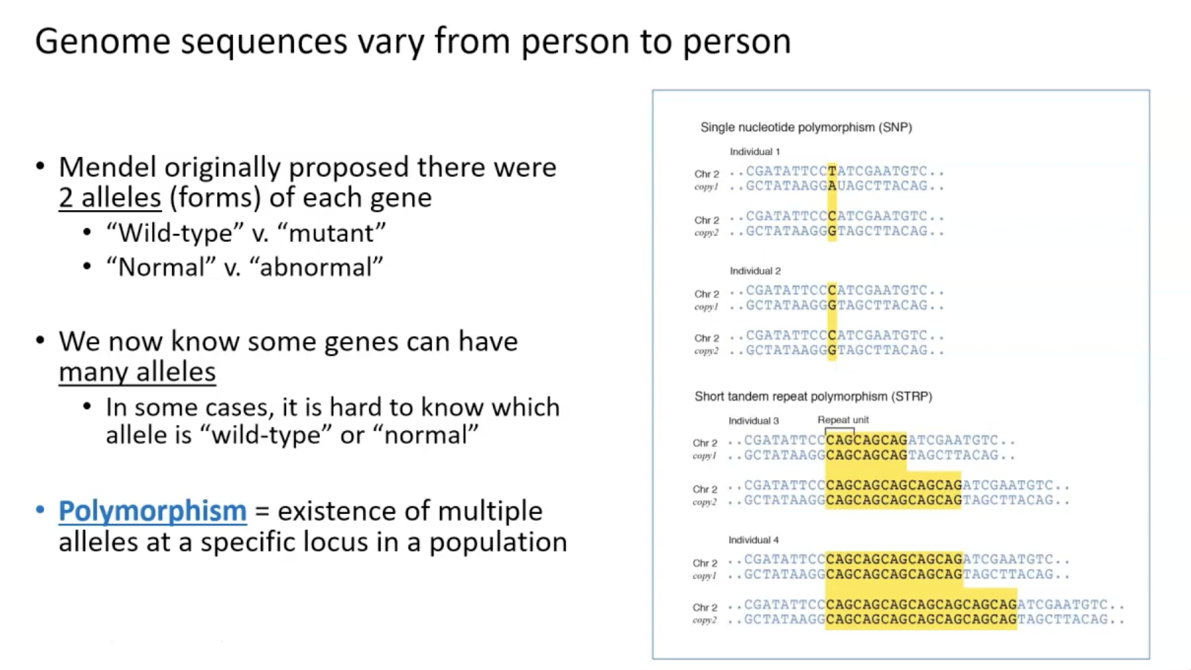

Notes:
Our DNA isn’t the same for everyone—it varies from person to person. A long time ago, a scientist named Mendel thought genes only came in two versions, like ‘normal’ and ‘mutant.’ But now we know some genes can have many versions, called alleles. When a spot in the DNA has multiple versions in a population, we call it a polymorphism. One type is a Single Nucleotide Polymorphism, or SNP, where just one letter in the DNA code changes—like a ‘C’ to a ‘T.’ Another type is a Short Tandem Repeat Polymorphism, or STRP, where small chunks of DNA repeat different numbers of times, like ‘CAG’ repeating 3 times in one person and 5 times in another. These differences are what GWAS looks at and tries to associate with diseases.

Slide 6
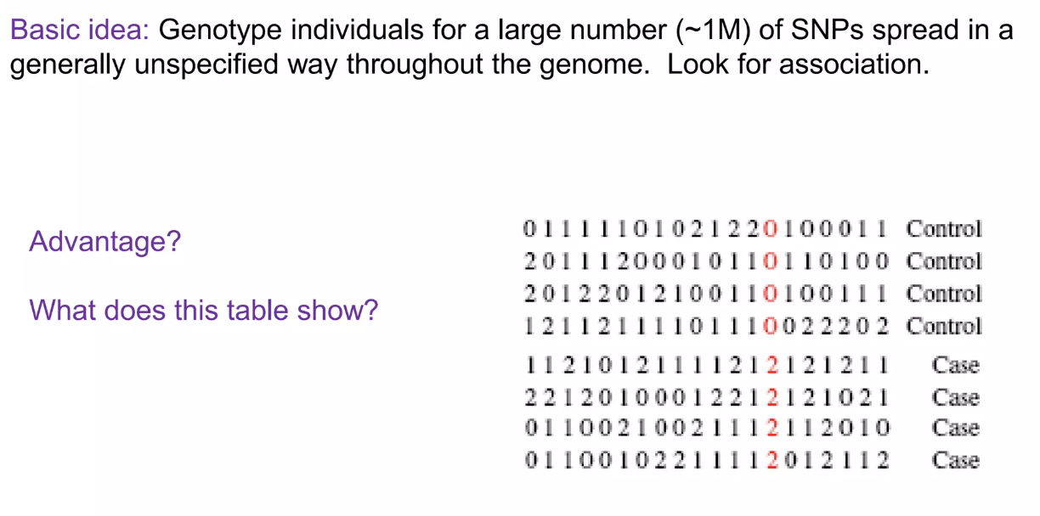
GWAS
Notes:
"GWAS starts with a simple idea: we look at the DNA of lots of people—about a million tiny DNA changes called SNPs, which are spread across the entire genome. SNPs are like little spelling differences in your DNA code. We compare two groups: people with a disease, called cases, and healthy people, called controls. The table here shows some example DNA data. Each row is a person, and the numbers represent their DNA code for different SNPs. For example, ‘0’ might mean they have two copies of the common version of a SNP, ‘1’ means one copy of the rare version, and ‘2’ means two copies of the rare version. We use this data to see which SNPs are more common in cases versus controls.

Slide 7
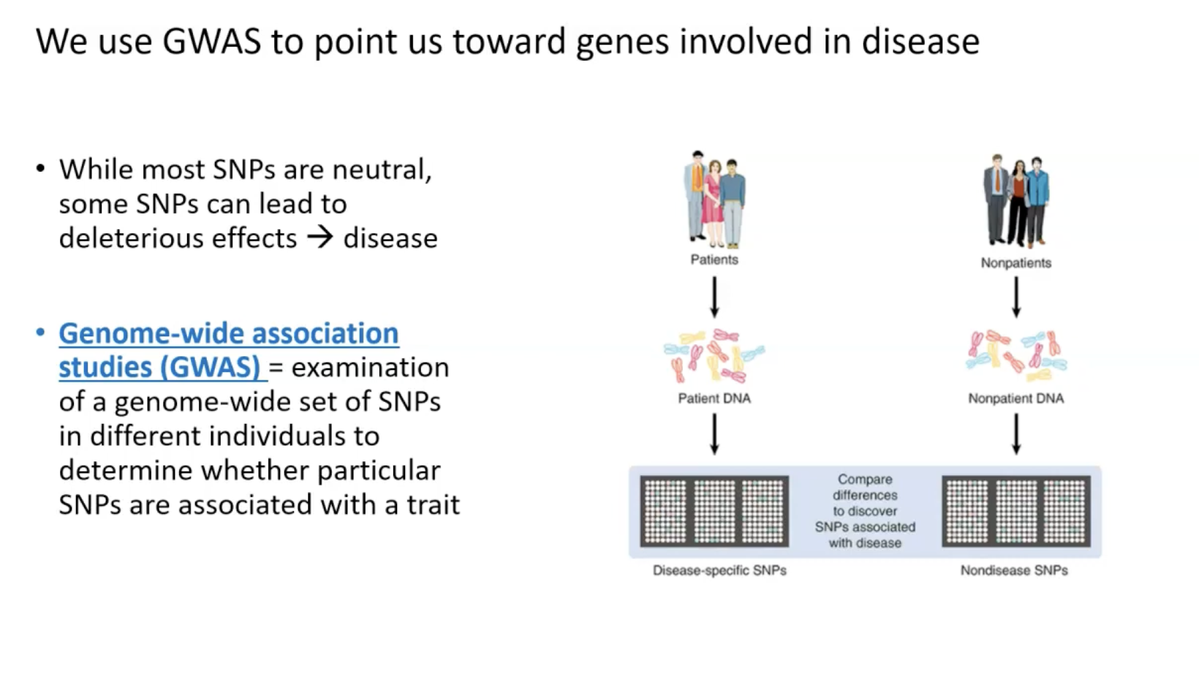

Slide 8
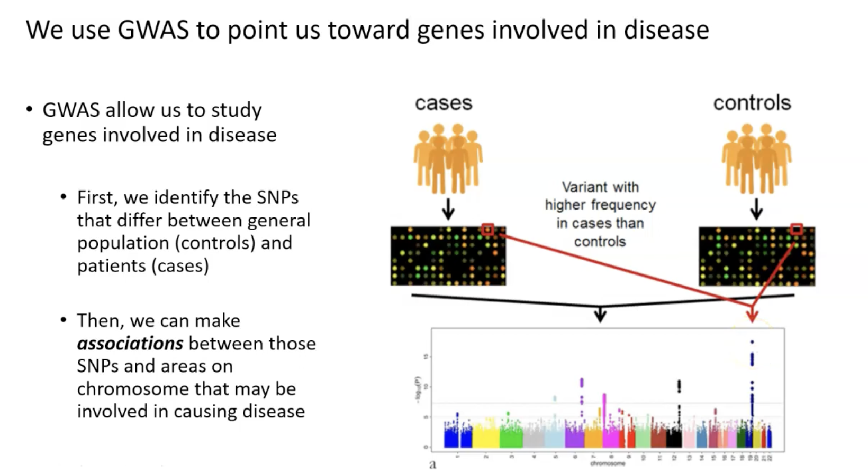
Notes:
"GWAS is a tool to find genes that might cause diseases. First, we look for SNPs that are different between healthy people (controls) and people with the disease (cases). For example, if a certain SNP is much more common in cases, it might be near a gene that’s involved in the disease.. Once we find these SNPs, we can narrow down areas on the chromosomes that might be linked to the disease.” so we start with geneotype data from participants and recorded phenotype data such as presence or absence of a disease or for quantitative measurements like BMI, bp their values are recorded

Slide 9
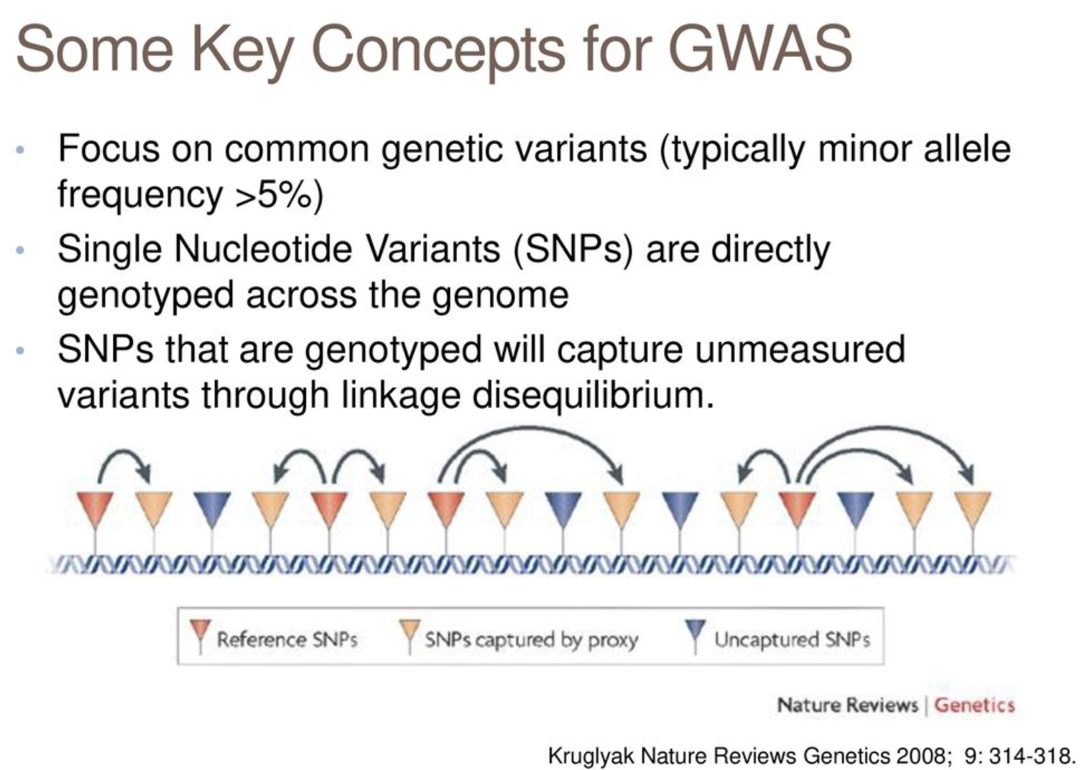
Notes:
”before we get into how we do GWAS, Let’s go over some general ideas in GWAS. First, GWAS focuses on common SNPs across the whole genome- ones that at least 5% of people have. we have 3billion ps and Not every SNP is tested directly, though. Some SNPs are close to each other on the DNA, so they tend to be inherited together. This is called linkage disequilibrium, or LD. Because of LD, testing one SNP can give us information about nearby SNPs we didn’t test. so gwas finds causal snps from tag snps by first identifying a region of interest through significant association with a trait using the tag snp then using a technique called fine mapping to pinpoint the causal variant within that region. The diagram shows this: reference SNPs are the ones we test, and they can ‘capture’ nearby untested SNPs through LD, but some SNPs are too far away to be captured.” Genrally, the factoe affecting LD is recombination of chromosomal segements. Genetic recombination (also known as genetic reshuffling) is the exchange of genetic material between different organisms which leads to production of offspring. The AFR pop has smalles LD blocks and caucaisians have longest since the population is known to have evolved from AFR and hence most recombinations has happened in that genome. Its just like when you take threads of same sized. When u cut one 10 times you get smaller chunks and when you cut it just thrice you get longer chunks. so all snps in these chunks called ld blocks are always inherited together

Slide 10
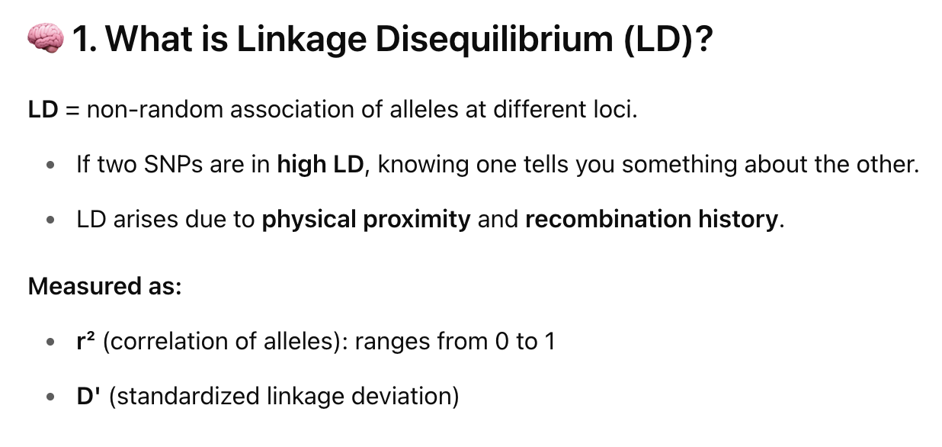
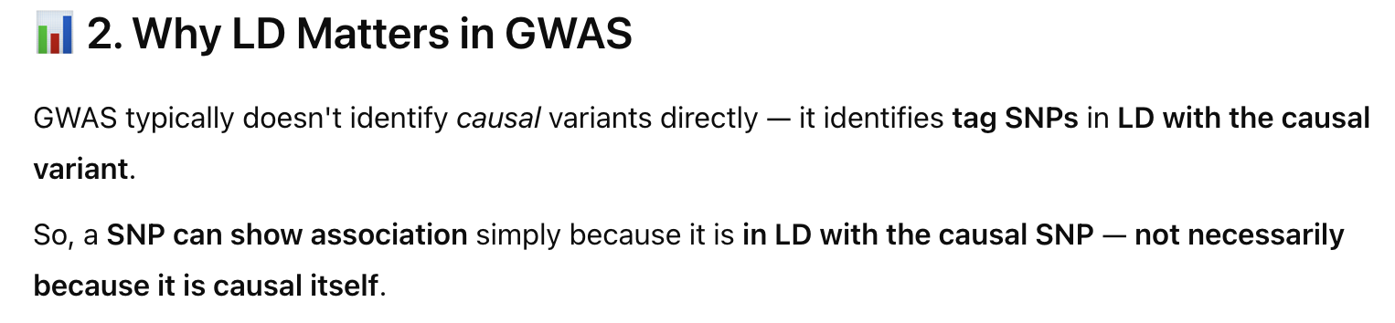
Notes:
"Linkage disequilibrium, or LD, is a fancy term for when two SNPs are inherited together more often than we’d expect by chance. Imagine two SNPs as neighbors on a chromosome. If they’re really close, they usually stick together when DNA is passed down through generations. We measure LD with two numbers: r², which tells us how strongly they’re linked, from 0 (not linked) to 1 (always together), and D’, which is another way to measure this. Why does LD matter in GWAS? Because GWAS doesn’t usually find the exact DNA change causing a disease—it might finds a nearby SNP that’s linked to it through LD. That nearby SNP is called a tag SNP."

Slide 11
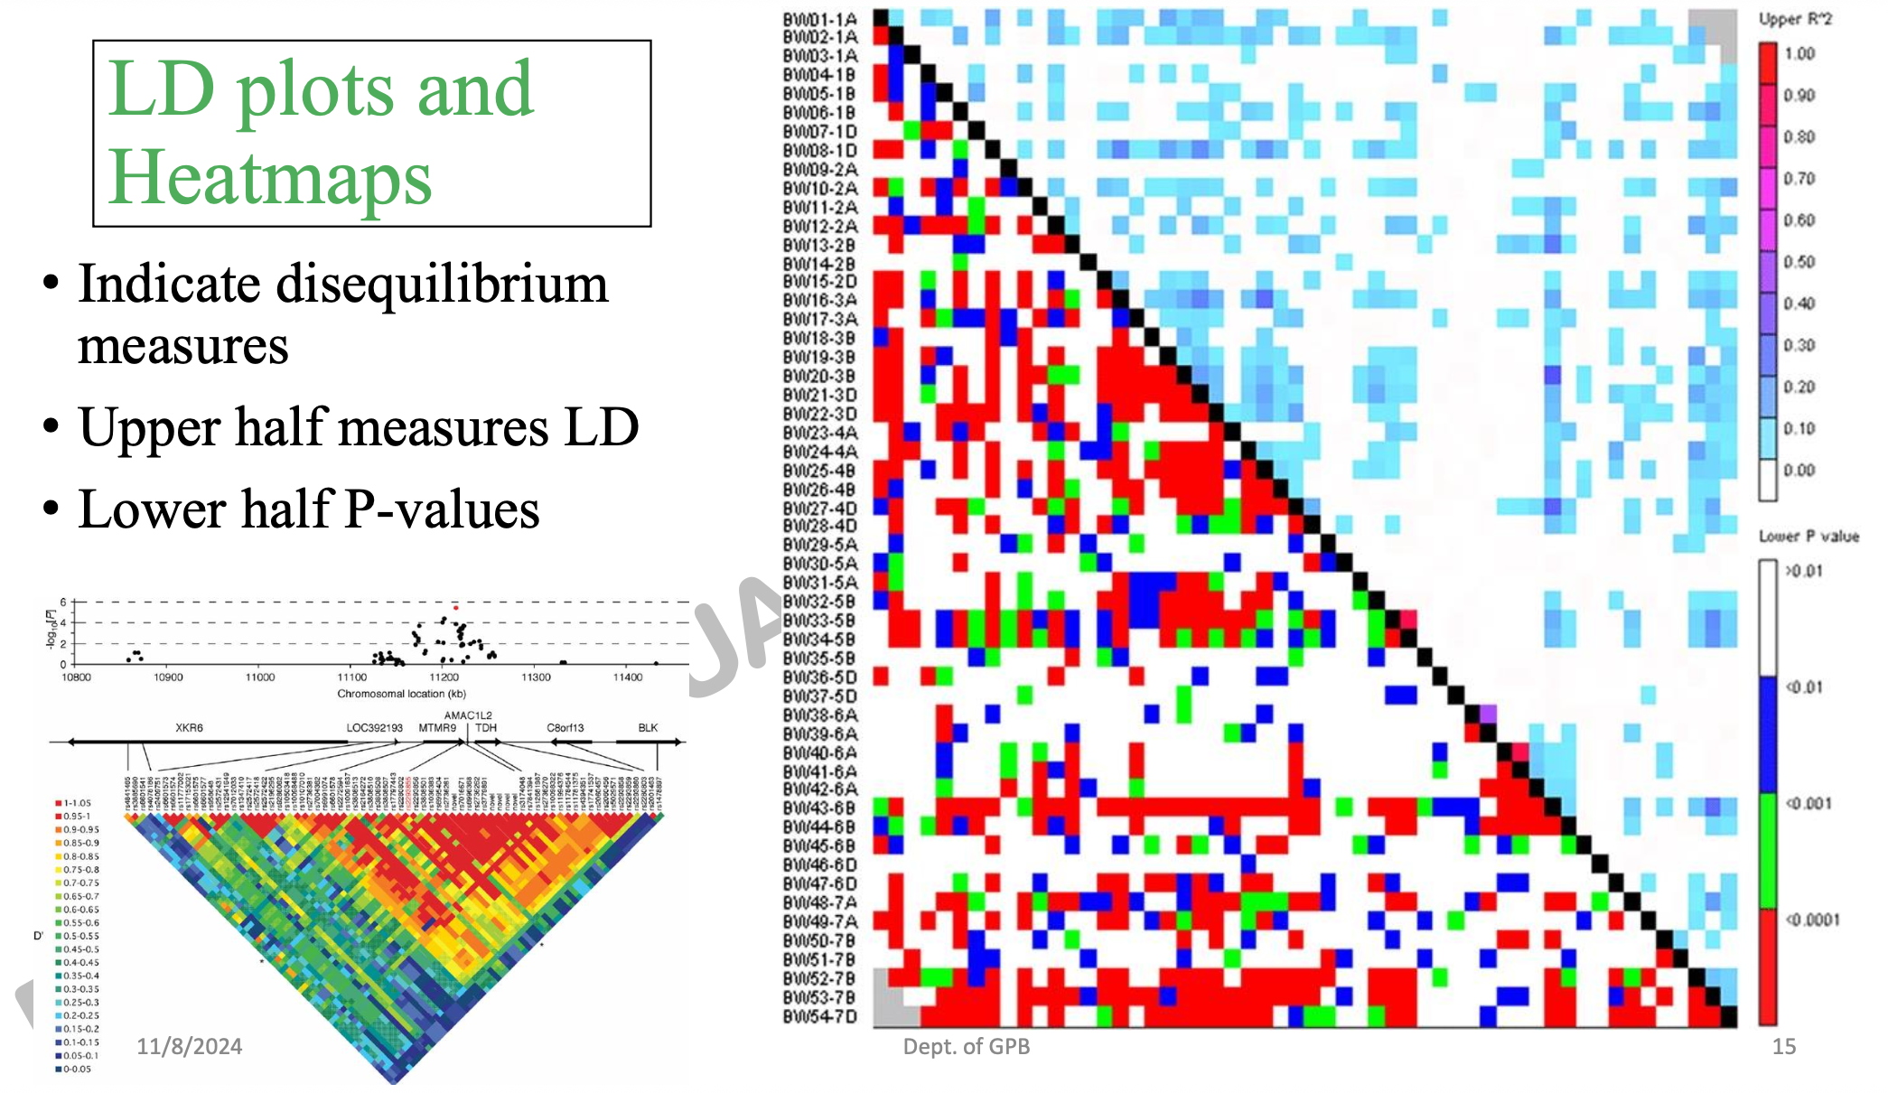
Notes:
"This slide mentions a type of plot we can make to show LD. In this plot, the upper half shows LD measures, like r², between pairs of SNPs—basically, how linked they are. The lower half shows p-values, which tell us if the connection between those SNPs and a disease is statistically significant. We’ll talk more about p-values later, but for now, just know this plot helps us see both how SNPs are related to each other and how they’re related to the disease."

Slide 12
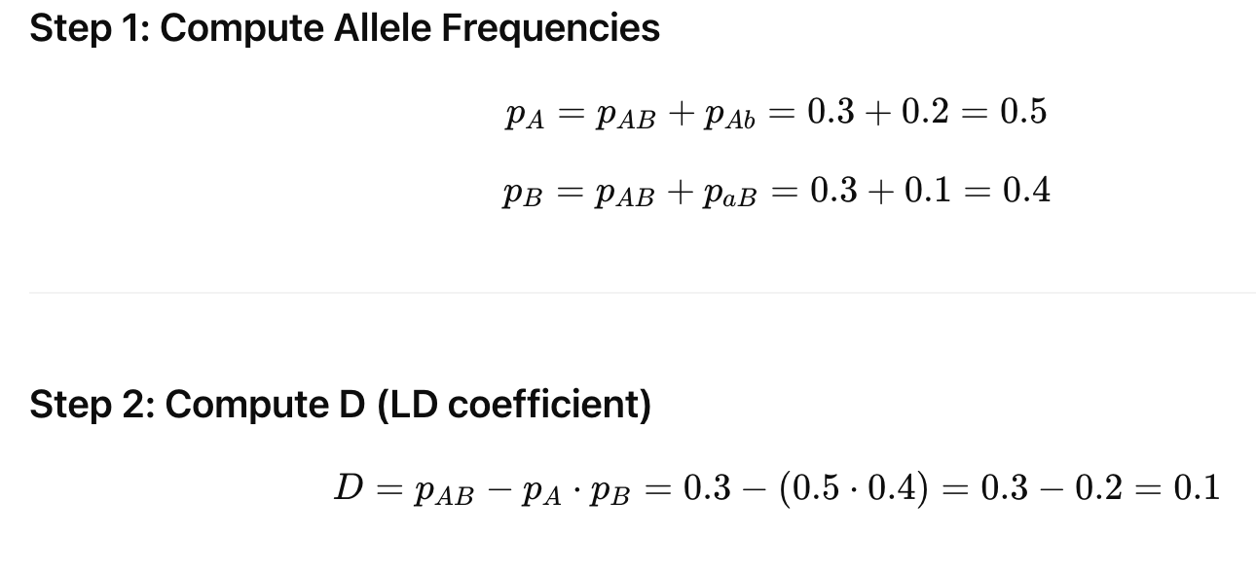
LD Calculation
SNP1
 | A | a
B | 0.3 | 0.1
b | 0.2 | 0.4
SNP2
pB=0.4
Pb=0.6
pA=0.5 pa=0.5
Total = 1
Notes:
"Let’s walk through an example of how to measure LD between two SNPs, called SNP 1 and SNP 2. The table shows the frequency of their combinations in a population. For example, 30% of people have the ‘A’ allele of SNP 1 and the ‘B’ allele of SNP 2 together. First, we calculate the frequency of each allele: the ‘A’ allele of SNP 1 is in 50% of people, and the ‘B’ allele of SNP 2 is in 40%. Then, we calculate a number called D, which measures LD. We expect A and B to occur together 20% of the time if they’re not linked (that’s 0.5 times 0.4), but they actually occur 30% of the time. So, D is 0.3 minus 0.2, which equals 0.1. This tells us they’re linked a little bit."

Slide 13
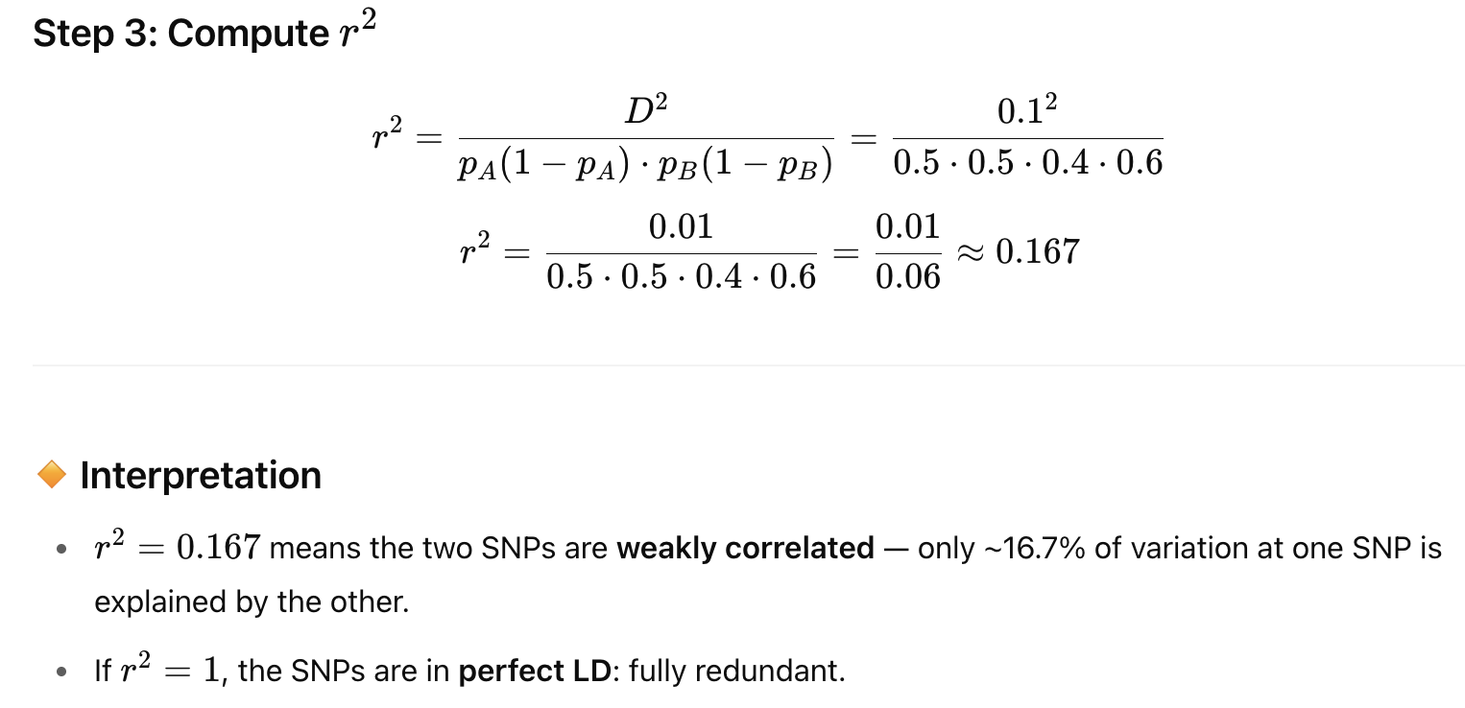
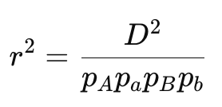
or
Notes:
"Now we take the D value from the last slide, which was 0.1, and use it to calculate r², another measure of LD. The formula for r² is D² divided by the product of the frequencies of each allele of the SNPs. Plugging in the numbers, we get 0.01 divided by 0.06, which is about 0.167. So, r² equals 0.167. This means the two SNPs are only weakly linked—only about 16.7% of the variation in one SNP is explained by the other. If r² were 1, they’d be perfectly linked, meaning they’re always inherited together."

Slide 14
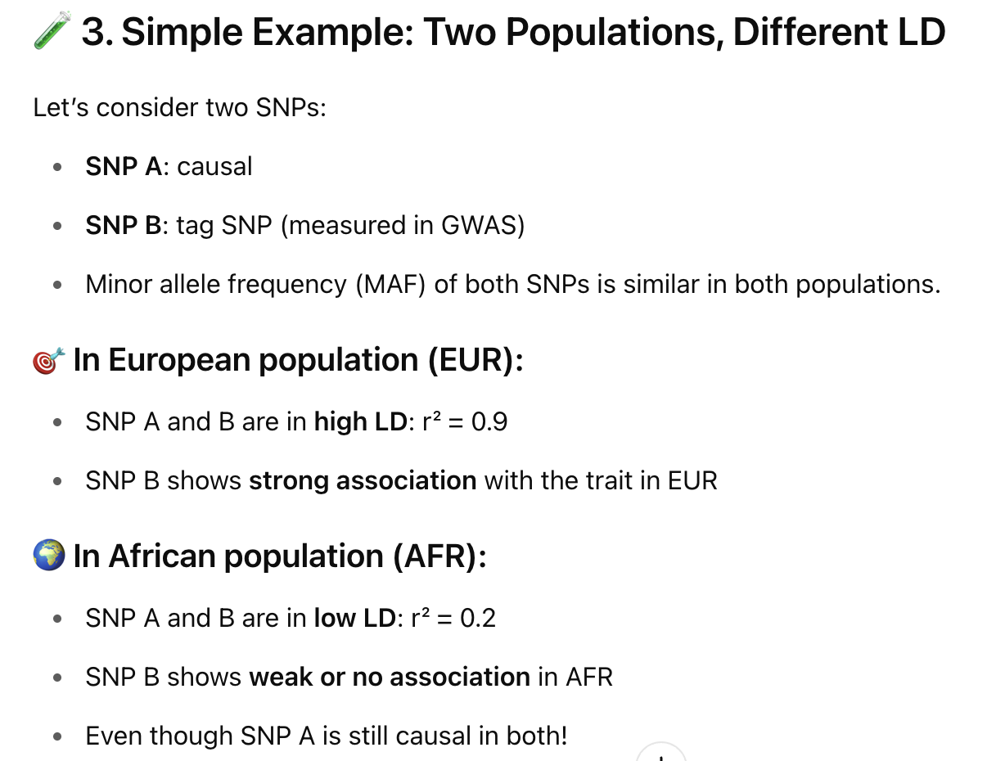
Two populations, different LD
Notes:
Most GWAS studies are done on European populations and we often apply that results to different ancestral populations like AFR. SAS.EAS/… When we do so we need to make sure the SNPs of interest are in LD with the tag SNPs. We will see how to do that in one of our next sessions. Because of differences in LD GWAS hits from EUR may not replicate in AFR if the tag SNP (B) is not in strong LD with the causal SNP (A). This is not because the biology is different — but because LD structure is different.
"LD can be different in different groups of people, and this affects GWAS results. Let’s look at two SNPs: SNP A, which actually causes a disease, and SNP B, which is nearby and measured in GWAS. In Europeans, SNP A and B are strongly linked, with an r² of 0.9, so SNP B looks strongly associated with the disease. But in Africans, the same SNPs are weakly linked, with an r² of 0.2, so SNP B doesn’t show a strong association, even though SNP A is still causing the disease. This shows how LD patterns can make GWAS results vary between populations, even if the biology is the same."

Slide 15
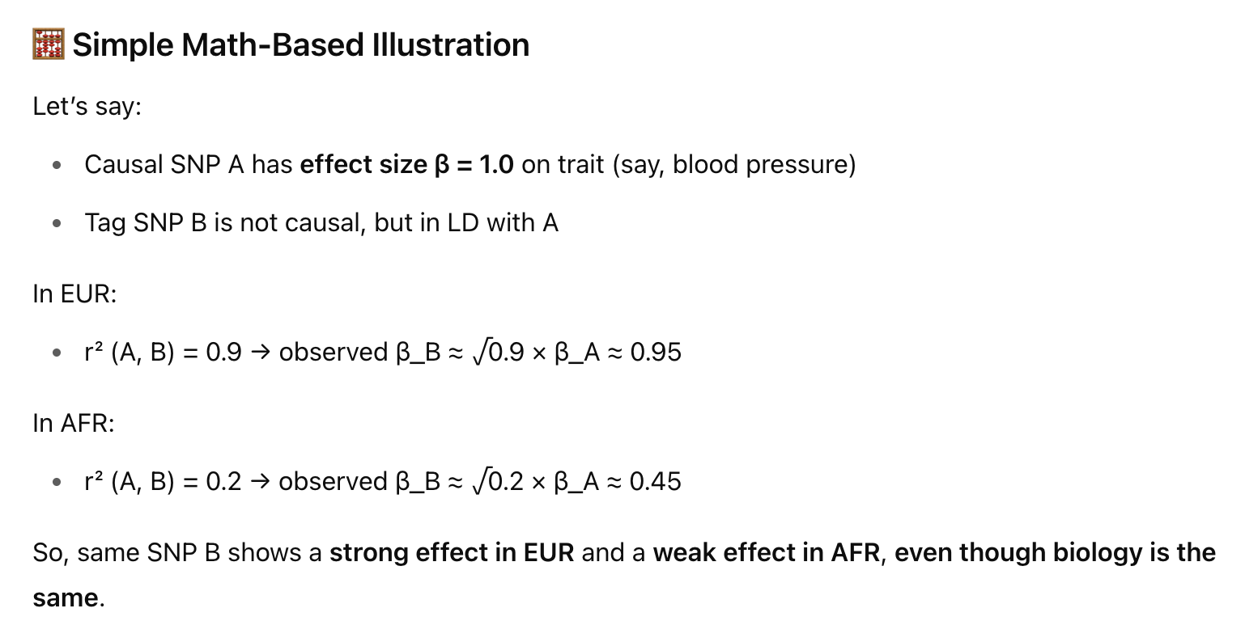
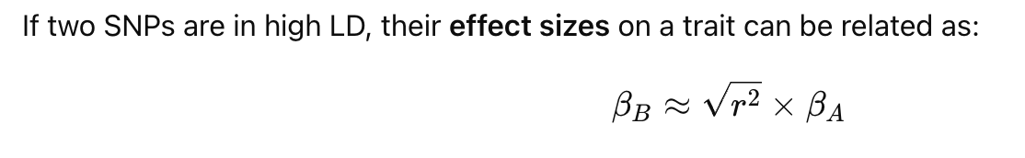
Notes:
"Let’s put some numbers to that last example. If two SNPs are in LD, their effects on a trait, like blood pressure, are related. The effect of the tag SNP, SNP B, is about the square root of r² times the effect of the causal SNP, SNP A. Say SNP A increases blood pressure by 1 unit. In Europeans, where r² is 0.9, SNP B’s effect is the square root of 0.9, which is about 0.95, times 1—so, 0.95. In Africans, where r² is 0.2, SNP B’s effect is the square root of 0.2, about 0.45, times 1—so, 0.45. This means SNP B looks like it has a big effect in Europeans but a small effect in Africans, just because of LD differences."

Slide 16
How to generate GWAS summary statistics?
Notes:
"Now let’s talk about how we actually create the data from a GWAS, called summary statistics. These statistics summarize the results of the study, showing which SNPs are associated with the disease and how strong that association is

Slide 17
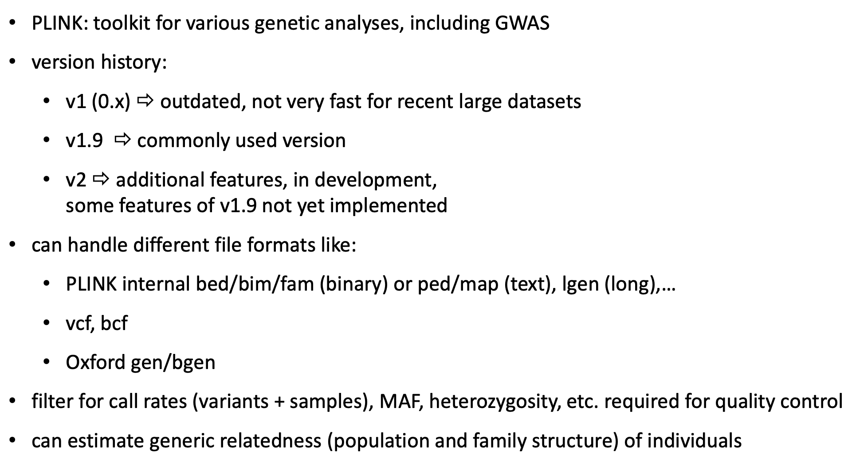
PLINK
Notes:
. The next few slides will show the steps to prepare the data, run the analysis, and get these summary statistics using a tool called PLINK, which is a popular program for GWAS analysis."

Slide 18
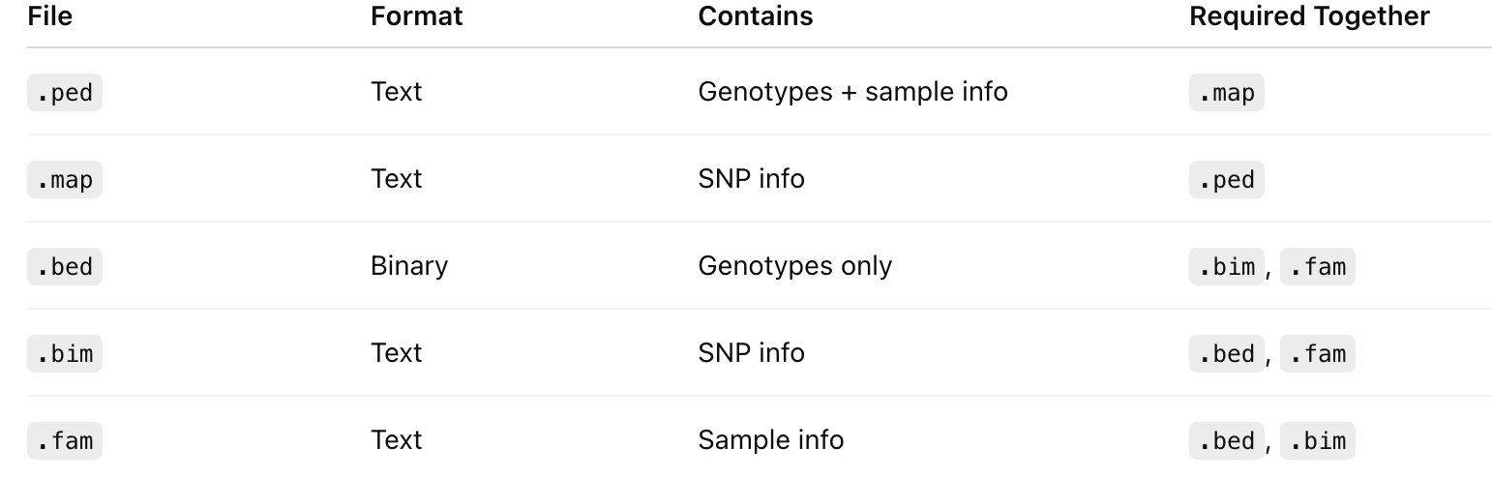
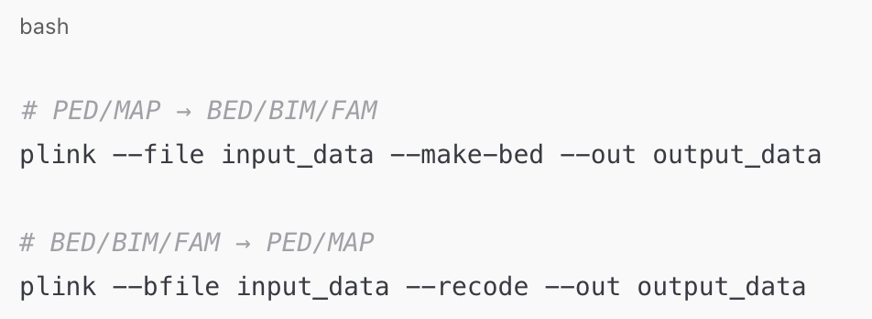
PLINK File Formats
Converting between formats
https://www.cog-genomics.org/plink/1.9/formats
Notes:
"PLINK uses specific file formats to store DNA data. There are two main sets of files. The first set is .ped and .map files: .ped has the DNA data for each person, like their SNPs, and .map has info about the SNPs, like their position on the chromosome. The second set is .bed, .bim, and .fam files: .bed is a compressed version of the DNA data, .bim is like .map with SNP info, and .fam has info about the people, like their family and disease status. You can convert between these formats using PLINK commands, like turning .ped and .map into .bed, .bim, and .fam, which are faster to work with."

Slide 19
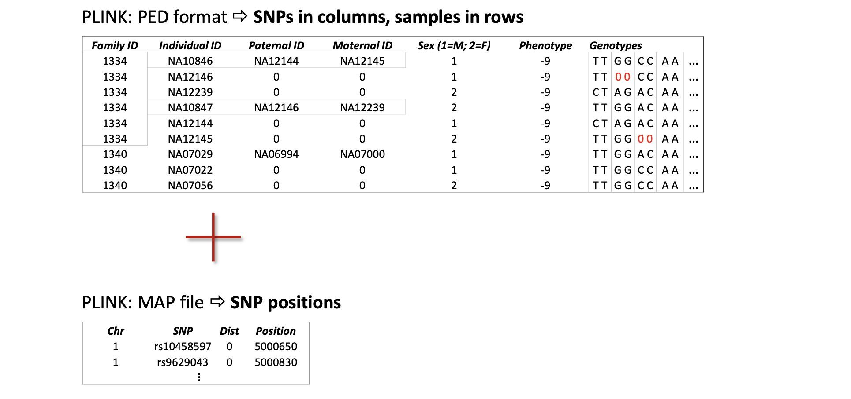
PLINK File Formats
Phenotype
For quantitative traits: A real number (e.g., 172.4, 0.57, etc.)
For case/control traits: Usually coded as 1 = control, 2 = case
Missing phenotype: -9
Notes:
Here’s what .ped and .map files look like. The .ped file has rows for each person, with columns like their family ID, individual ID, and their DNA data—each SNP is shown as two letters, like ‘A A’ or ‘A T,’ representing the two copies of their DNA. The .map file has info about each SNP, like which chromosome it’s on, its ID (like rs12345), and its position on the chromosome in base pairs, which is like its address on the DNA."
For quantitative traits: A real number (e.g., 172.4, 0.57, etc.)
For case/control traits: Usually coded as 1 = control, 2 = case

Slide 20
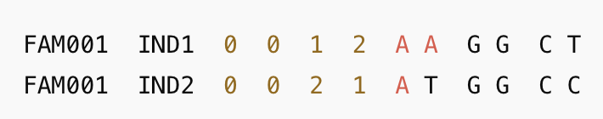
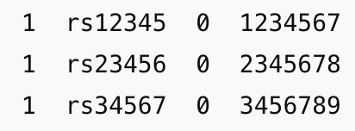
.ped
Genotypes for each individual. Each SNP is represented by two alleles (e.g., A T, G G, etc.)
.map
SNP metadata (no genotype data)
Notes:
Map SNP metadata (no genotype data)
"Here’s what .ped and .map files look like. The .ped file has rows for each person, with columns like their family ID, individual ID, and their DNA data—each SNP is shown as two letters, like ‘A A’ or ‘A T,’ representing the two copies of their DNA. The .map file has info about each SNP, like which chromosome it’s on, its ID (like rs12345), and its position on the chromosome in base pairs, which is like its address on the DNA."

Slide 21
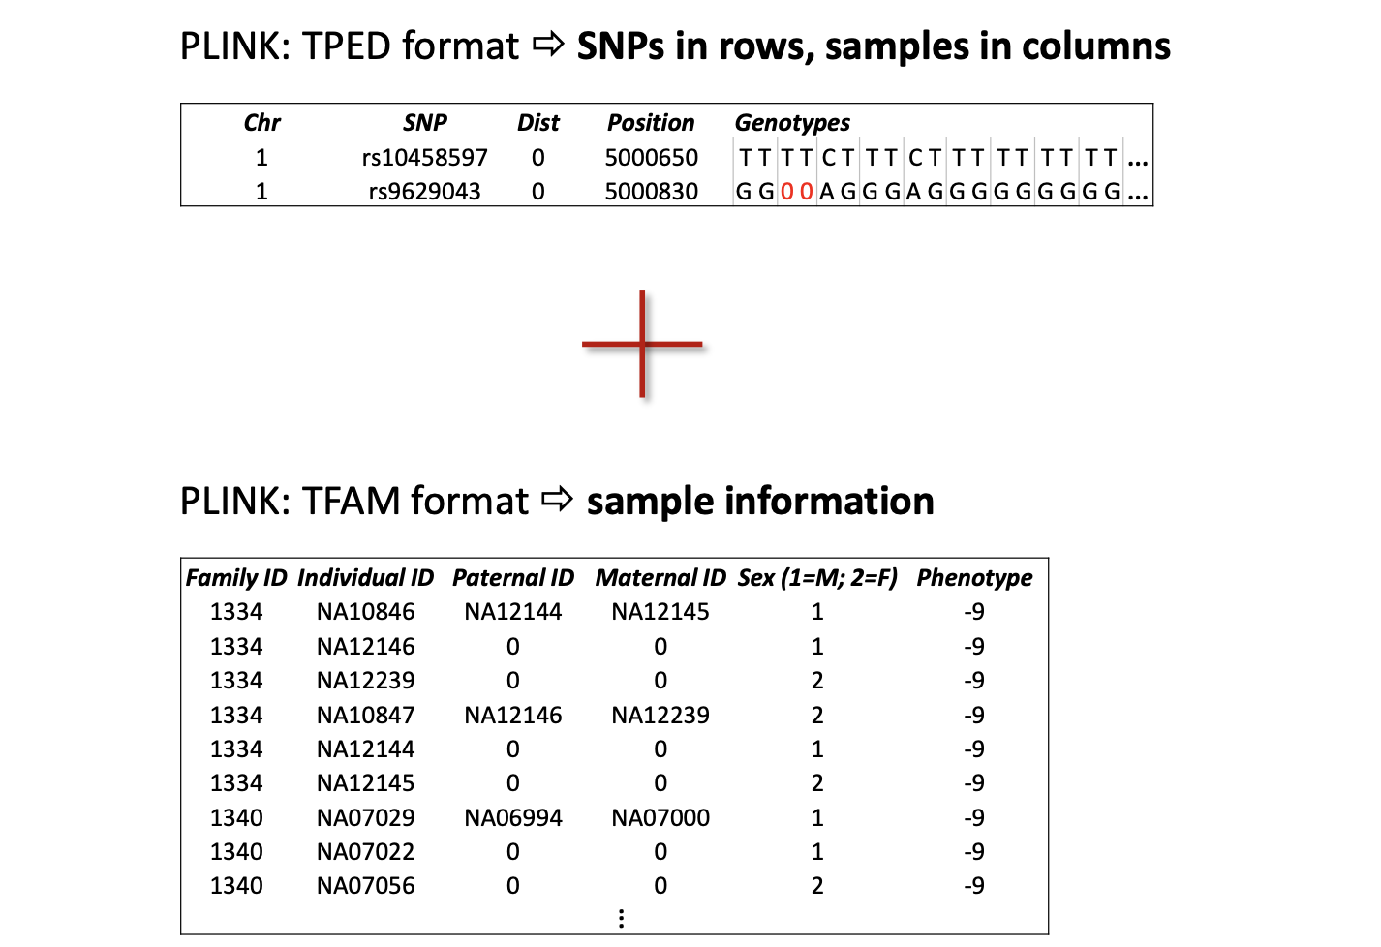
PLINK File Formats

Slide 22
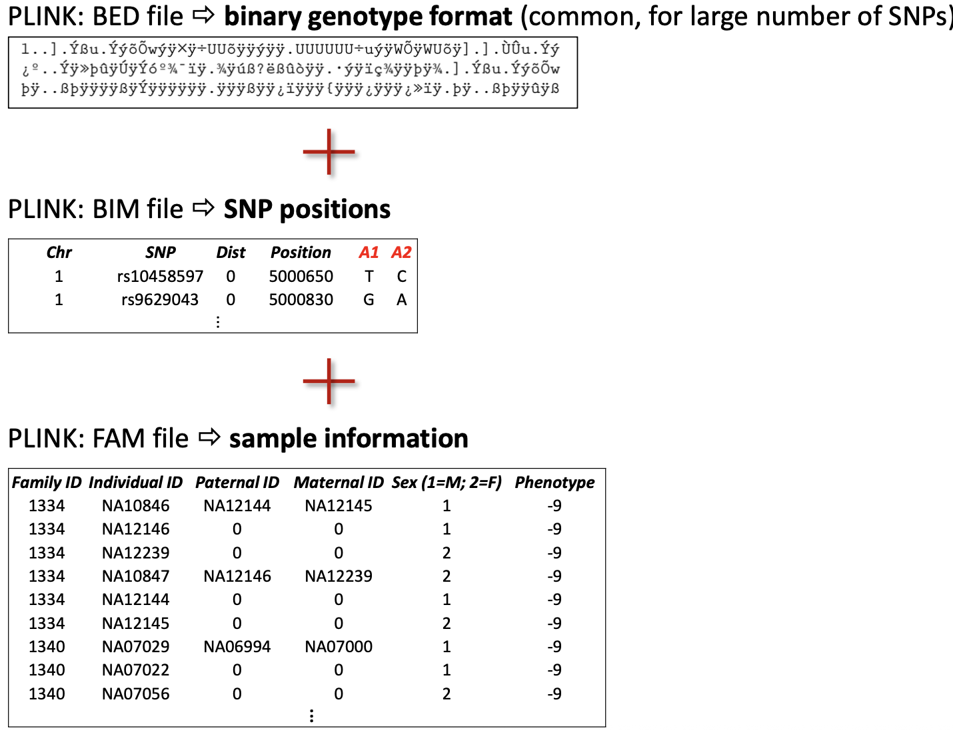
PLINK File Formats
Notes:
"Now let’s look at the other format: .bed, .bim, and .fam files. The .bed file is a compressed version of the DNA data, so it’s not human-readable, but it’s faster for computers to use. The .bim file is like the .map file, listing each SNP’s chromosome, ID, position, and the two possible alleles of the SNP, like ‘A’ and ‘G.’ The .fam file has info about each person, like their family ID, individual ID, and whether they’re a case or control, but it doesn’t include the DNA data itself."
Extension: .bed
Content: Binary-encoded genotype data
Advantage: Faster loading, smaller file size.
Requires .bim and .fam to interpret.
Extension: .bim
Content: SNP metadata.
Structure (tab-delimited):
Extension: .fam
Content: Sample metadata (like PED without genotype columns).
Structure (space-delimited):

Slide 23
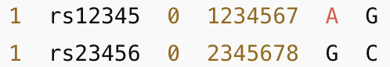
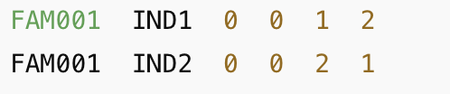
.bed
Binary-encoded genotype data
.bim
SNP metadata
.fam
Sample metadata (like PED without genotype columns).
Notes:
"Now let’s look at the other format: .bed, .bim, and .fam files. The .bed file is a compressed version of the DNA data, so it’s not human-readable, but it’s faster for computers to use. The .bim file is like the .map file, listing each SNP’s chromosome, ID, position, and the two possible versions of the SNP, like ‘A’ and ‘G.’ The .fam file has info about each person, like their family ID, individual ID, and whether they’re a case or control, but it doesn’t include the DNA data itself."
Extension: .bed
Content: Binary-encoded genotype data
Advantage: Faster loading, smaller file size.
Requires .bim and .fam to interpret.
Extension: .bim
Content: SNP metadata.
Structure (tab-delimited):
Extension: .fam
Content: Sample metadata (like PED without genotype columns).
Structure (space-delimited):

Slide 24
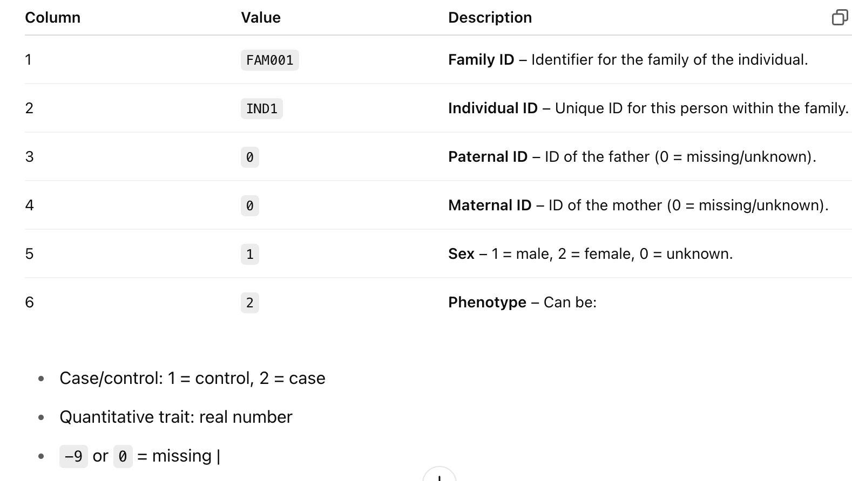
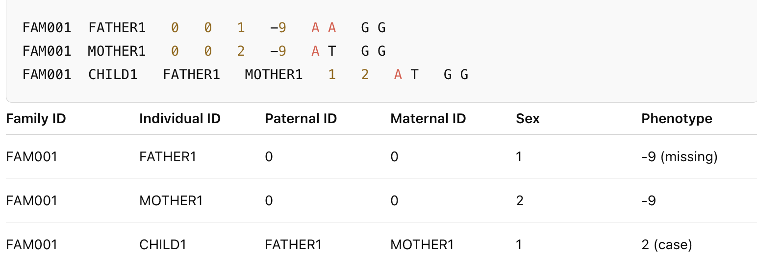
Metadata
Notes:
"The .fam file has important details about each person in the study. Here’s what the columns mean: the first is the family ID, the second is the individual ID, the third and fourth are the IDs of the parents (0 means unknown), the fifth is sex—1 for male, 2 for female, 0 for unknown—and the sixth is the phenotype, which tells us if they’re a case or control. For example, 1 means control, 2 means case, and 0 or -9 means missing data. This helps us keep track of who’s who in the study."

Slide 25
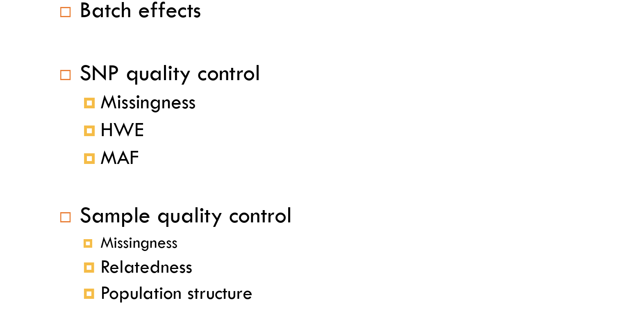
Quality Control
Notes:
"Before we analyze the data, we need to clean it up—this is called quality control. We check for things that could mess up our results, like batch effects (differences in how the DNA was processed), SNP quality (are some SNPs poorly measured?), and sample quality (are some people’s DNA data unreliable?). We look at things like missing data, Hardy-Weinberg Equilibrium (which checks if SNP frequencies are as expected), minor allele frequency (how common the SNP is), relatedness between people, and population structure (differences in ancestry). The next slides will show how we do this."

Slide 26
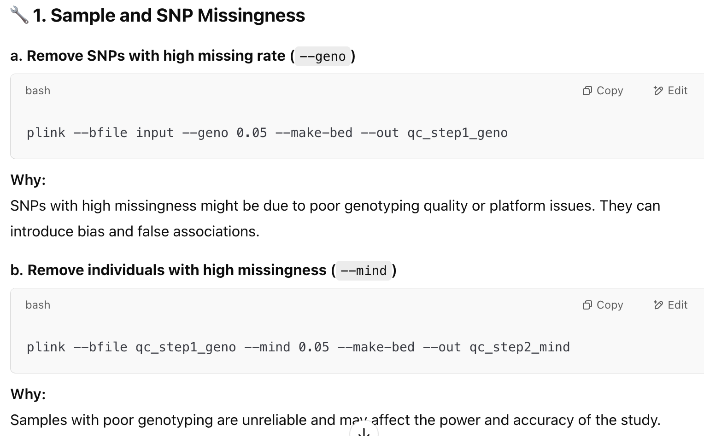
Notes:
"First, we check for missing data. Some SNPs might have a lot of missing information because of bad measurements, so we remove those using a PLINK command called --geno. Here, we set a threshold of 0.05, meaning we remove SNPs with more than 5% missing data. We also check for people with lots of missing DNA data using the --mind command, again with a 5% threshold. Why? Missing data can lead to wrong results, so we want to make sure our data is reliable before we analyze it."

Slide 27
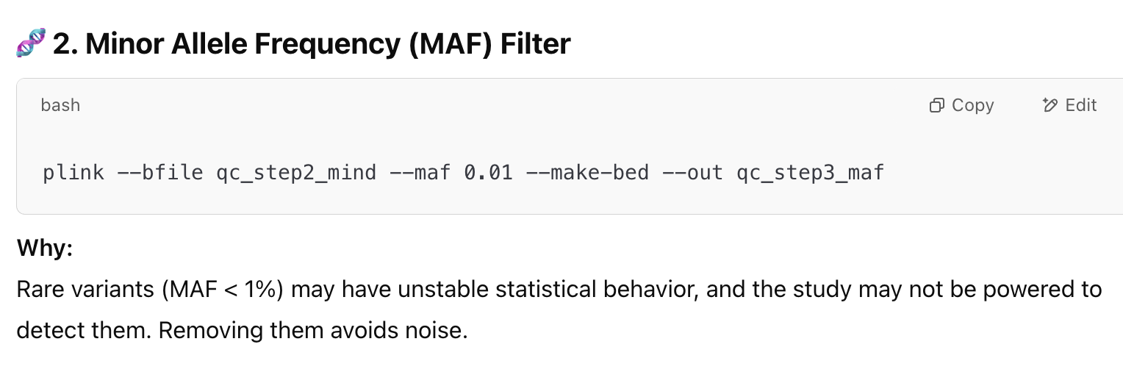
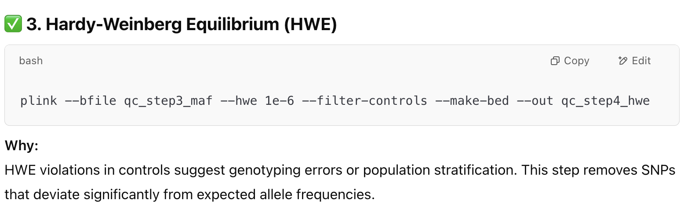
Notes:
"Next, we filter out rare SNPs using the minor allele frequency, or MAF. We use the --maf command to remove SNPs where the rare allele called the minor allele is in less than 1% of people, because rare SNPs can be hard to analyze accurately. Then, we check Hardy-Weinberg Equilibrium, or HWE, using the --hwe command. HWE is a rule that says the frequency of SNP alleles should be stable in a population unless something’s wrong, like a genotyping error. We remove SNPs that violate HWE in controls, with a threshold of 1e-6, meaning the chance of this happening by random chance is less than 1 in a million."

Slide 28
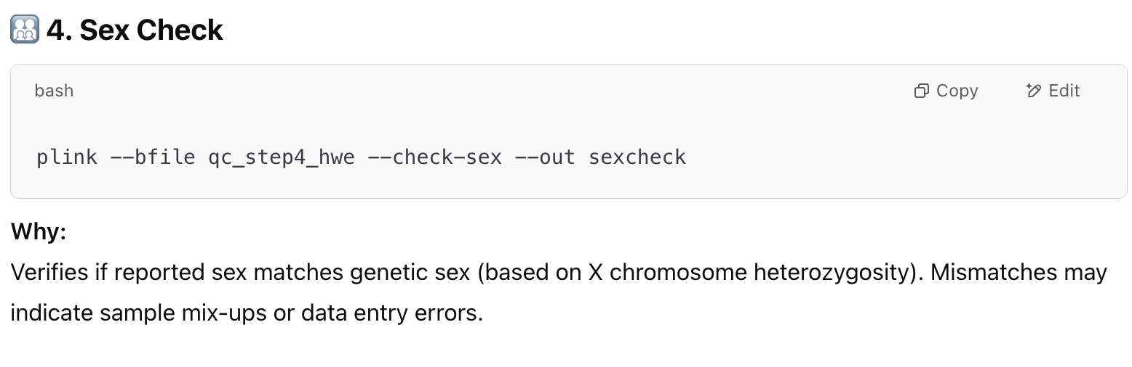
Notes:
"We also check if the reported sex of each person matches their DNA. PLINK’s --check-sex command looks at the X chromosome—females should have two X chromosomes, so they can have two different alleles of a SNP, while males have one X, so they can’t. If the reported sex doesn’t match the DNA, it might mean the samples got mixed up, so we can fix or remove those samples to avoid mistakes in our analysis."

Slide 29
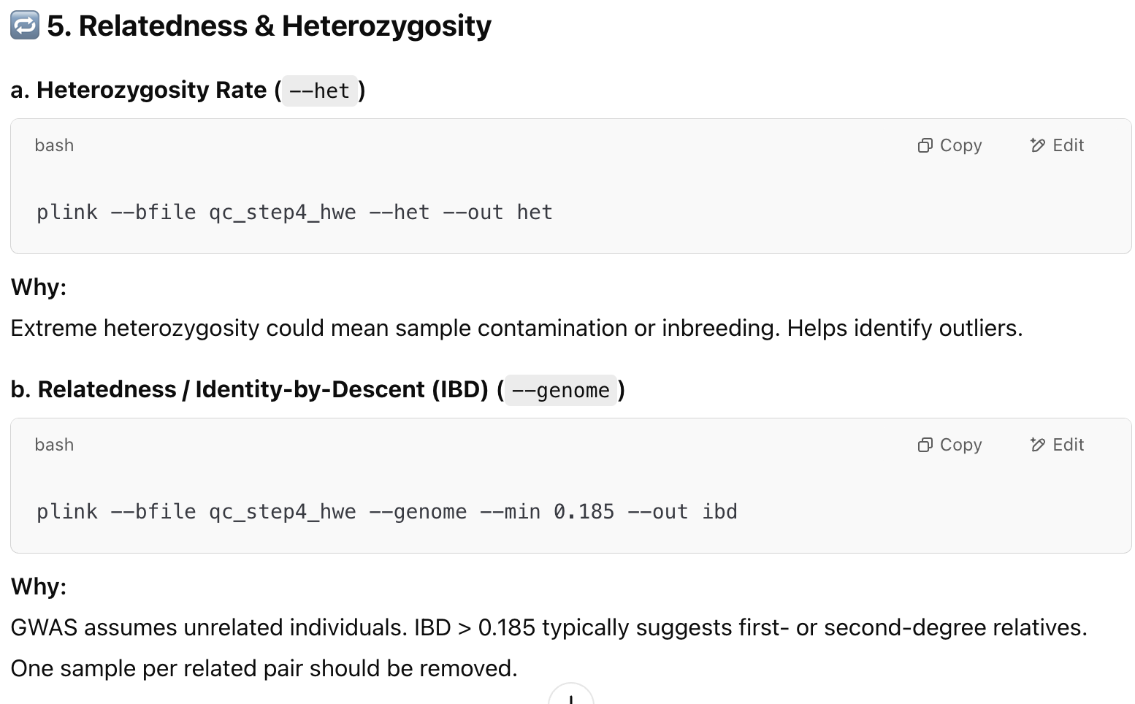
Notes:
"Now we check for relatedness and heterozygosity. Heterozygosity means having two different alleles of a SNP, like ‘A T.’ We use the --het command to check if some people have unusual levels of heterozygosity, which might mean their sample is contaminated. We also check for relatedness using the --genome command. GWAS assumes people aren’t related, but if they are—like siblings—their DNA will be too similar. We look for pairs with an IBD score over 0.185, which means they’re likely first- or second-degree relatives, and remove one person from each related pair."

Slide 30
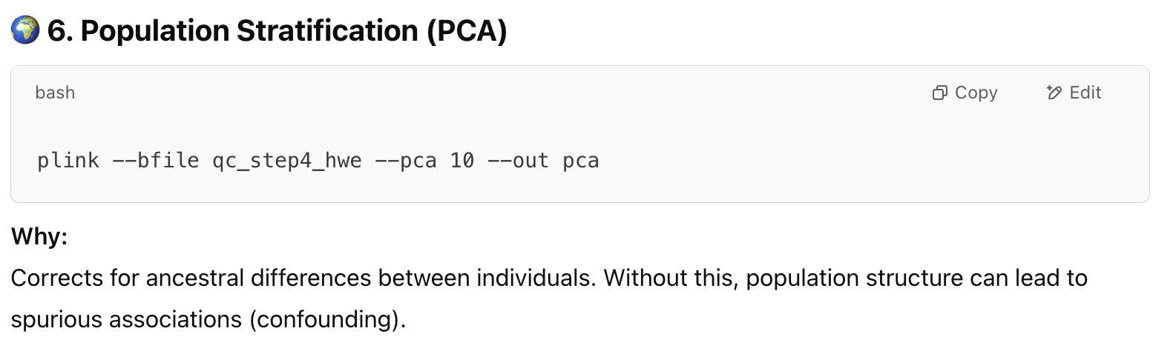
Notes:
"Finally, we check for population structure, which means differences in ancestry between people in the study. Imagine your dataset includes people from multiple ancestries — like European and African populations. Their allele frequencies differ — not due to disease, but due to population history.Without correcting for ancestry, your GWAS might falsely identify SNPs that just tag population differences, not the actual disease.
We use the --pca command in PLINK to run a Principal Component Analysis, or PCA, which identifies these ancestry differences. We can then use this info to adjust our analysis so ancestry doesn’t mess up our results."
. For example, if some people are European and others are African, their DNA might differ in ways that aren’t related to the disease, which can lead to false results

Slide 31
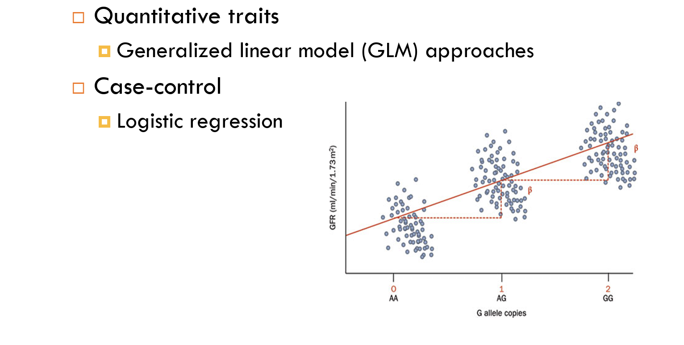
Statistical Testing - Association
Notes:
"Once our data is clean, we do statistical tests to find SNPs associated with the disease. For traits that are numbers, like height, we use a method called a generalized linear model, or GLM. For diseases, where people are either cases or controls, we use logistic regression, which compares the two groups to see which SNPs are more common in cases. These tests give us a p-value, which tells us how likely it is that our result happened by chance."

Slide 32
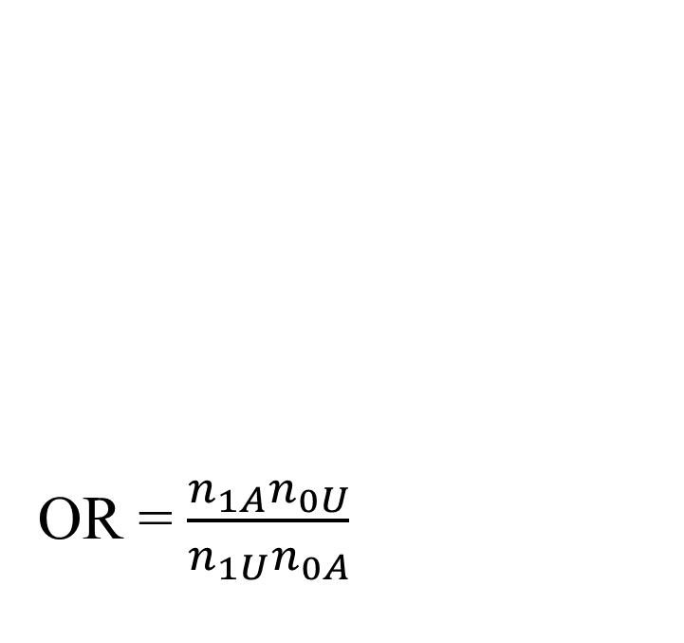
Case-control
Each individual contributes two counts to 2x2 table.
Test of association
where
X² has χ² distribution with 1 degrees of freedom under null hypothesis.
 | Cases | Controls | Total
G | n_{1A} | n_{1U} | n_{1·}
T | n_{0A} | n_{0U} | n_{0·}
Total | n_{·A} | n_{·U} | n··
Odds of having G (vs T) in cases vs. controls.
OR > 1: G allele may be risk allele
OR < 1: G may be protective
Notes:
"For case-control studies, we make a table comparing cases and controls for each SNP. We count how often each allele of the SNP appears in each group and use a chi-square test to see if the difference is significant. We also calculate an odds ratio, or OR, which tells us how much more likely the SNP is in cases versus controls. If the OR is greater than 1, the SNP might increase disease risk. If it’s less than 1, it might protect against the disease. The chi-square test gives us a p-value to check if the result is real or just random chance."
In a GWAS, we typically have:
A set of cases (individuals with the disease) and controls (without the disease)
For each SNP, individuals are categorized by genotype (e.g., G or T)
n₁A: Number of G alleles in cases
n₁U: Number of G alleles in controls
n₀A: Number of T alleles in cases
n₀U: Number of T alleles in controls
You use a chi-square test (χ²) to test if allele frequencies differ between cases and controls:
χ2=∑i=01∑j=AU(nij−E[nij])2E[nij]\chi^2 = \sum_{i=0}^{1} \sum_{j=A}^{U} \frac{(n_{ij} - \mathbb{E}[n_{ij}])^2}{\mathbb{E}[n_{ij}]}χ2=i=0∑1​j=A∑U​E[nij​](nij​−E[nij​])2​ Where:
E[nij]=ni.⋅n.jn..\mathbb{E}[n_{ij}] = \frac{n_{i.} \cdot n_{.j}}{n..}E[nij​]=n..ni.​⋅n.j​​ is the expected count under the null hypothesis of no association.
If the observed counts deviate significantly from expected counts, the SNP may be associated with the disease.
💡 Odds Ratio (OR):
Another measure used is the odds ratio (OR), defined as:
OR=n1A⋅n0Un1
This compares:
Odds of having G (vs T) in cases vs. controls.
OR > 1: G allele may be risk allele
OR < 1: G may be protective

Slide 33
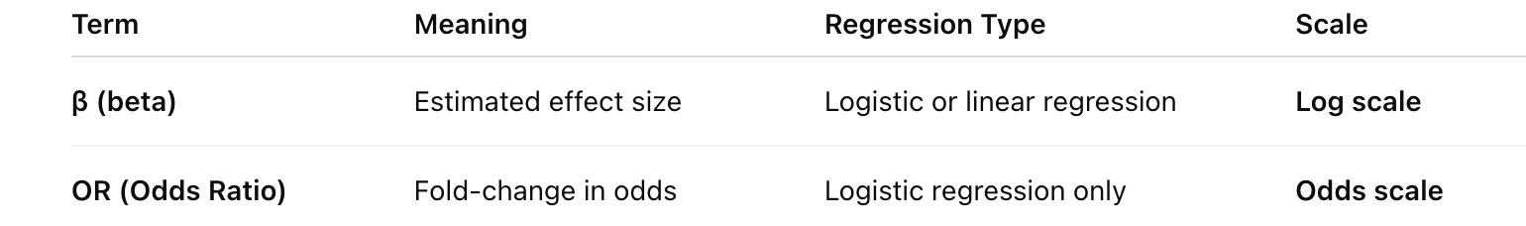
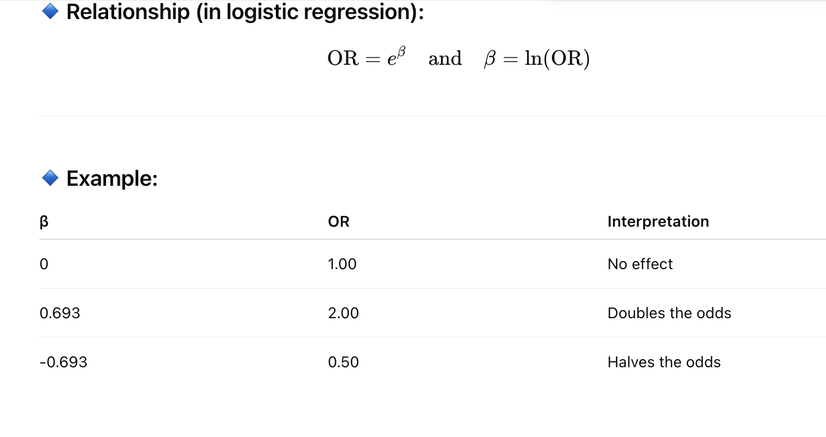
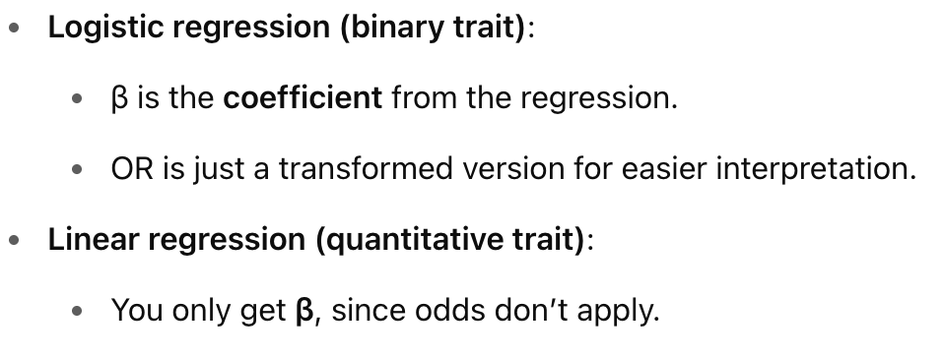
Effects size vs OR
Notes:
In the context of GWAS (Genome-Wide Association Studies) and logistic regression, Beta (β) and OR (Odds Ratio) are both measures used to describe the relationship between a SNP (a DNA variant) and a disease, but they represent different things.
It depends:
Many GWAS summary statistics report β and SE.
Some also report OR, especially for case-control studies.
Beta (β)
What it is: Beta is a number that comes from logistic regression, showing how much the log-odds of having the disease changes when you add one more copy of a specific SNP version (allele).
How to understand it: In logistic regression, we’re predicting the chance of being a case (having the disease) versus a control (not having it). Beta tells us the change in the "log-odds" (a mathematical way of expressing probability) for each extra copy of the allele.
If β is positive (e.g., 0.5), the allele increases the chance of the disease.
If β is negative (e.g., -0.5), the allele decreases the chance.
If β is 0, there’s no effect.
Units: It’s in log-odds, which isn’t directly intuitive—it’s a step before calculating the odds ratio.
Example: If β = 0.693 for a SNP, it means each copy of the allele increases the log-odds of the disease by 0.693.
OR (Odds Ratio)
What it is: The odds ratio is a more intuitive number that tells you how much more (or less) likely someone is to have the disease if they have the allele, compared to if they don’t. It’s directly related to Beta.
How to understand it: OR is calculated as e^β (the exponential of Beta). It compares the odds of disease in people with the allele to those without it.
If OR = 2, people with the allele are 2 times more likely to have the disease.
If OR = 1, there’s no difference in likelihood.
If OR = 0.5, people with the allele are half as likely to have the disease.
Units: It’s a ratio, so it’s easier to interpret than Beta—it directly tells you the change in risk.
Example: If β = 0.693, then OR = e^0.693 ≈ 2. This means the odds of having the disease are 2 times higher for each copy of the allele.
Key Differences
Definition: Beta (β) is the raw coefficient from logistic regression, measuring the change in log-odds. OR is the exponentiated form of Beta (OR = e^β), measuring the change in odds directly.
Interpretation: Beta is harder to interpret because it’s in log-odds (a mathematical scale). OR is easier—it directly tells you how much the odds of disease change (e.g., "twice as likely").
Scale: Beta can be any number (positive, negative, or zero). OR is always positive: OR > 1 means increased risk, OR < 1 means decreased risk, OR = 1 means no effect.
Use in GWAS: In PLINK output (like the .assoc.logistic file), you’ll see Beta for each SNP, and often the OR is calculated from it. OR is more commonly reported in papers because it’s easier to understand.
Example to Tie It Together
Imagine a SNP where β = 0.405 in the logistic regression output.
The OR would be e^0.405 ≈ 1.5.
This means:
Beta (0.405) tells us the log-odds of the disease increases by 0.405 for each copy of the allele.
OR (1.5) tells us the odds of having the disease are 1.5 times higher for each copy of the allele—much easier to grasp!
Why Both Are Useful
Beta: Used in the statistical model to calculate significance (p-values) and build predictions. It’s the raw output from logistic regression.
OR: Used to communicate results in a way that’s easier to understand, especially for non-experts, since it directly shows the change in risk.
In short, Beta is the mathematical building block, and OR is the human-friendly version of the same information!

Slide 34
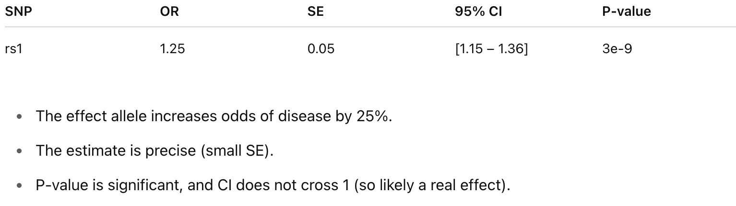
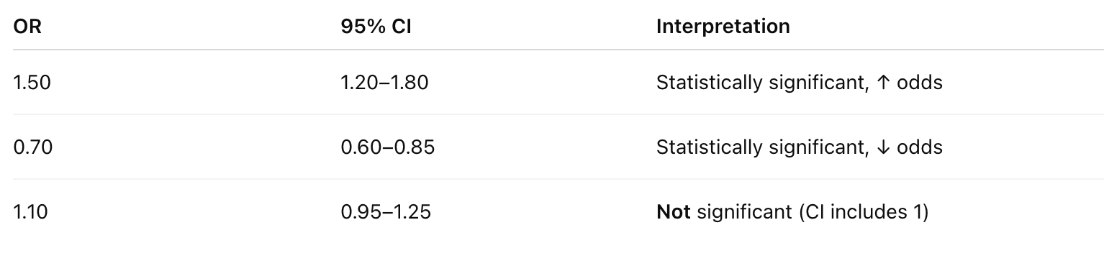
SE and CI
SE (Standard Error)
Measures the uncertainty in the effect size estimate (β).
Smaller SE → more precise estimate.
Used to compute confidence intervals and p-values.
CI (Confidence Interval)
Usually 95% CI.
Gives a range within which the true OR (or β) likely lies, with 95% confidence.
Notes:
1. OR (Odds Ratio)
Applies to binary traits (e.g. case vs. control).
Tells you how much carrying the effect allele changes the odds of having the trait.
Example:
If OR = 1.5: The effect allele increases the odds of disease by 50%.
If OR = 0.7: The effect allele decreases the odds by 30%.
OR is exponentiated effect size from logistic regression: OR=eβ\text{OR} = e^{\beta}OR=eβ
🔹 2. SE (Standard Error)
Measures the uncertainty in the effect size estimate (β).
Smaller SE → more precise estimate.
Used to compute confidence intervals and p-values.
🔹 3. CI (Confidence Interval)
Usually 95% CI.
Gives a range within which the true OR (or β) likely lies, with 95% confidence.
Computed as:
For logistic regression (OR):
CI95%=[eβ−1.96⋅SE, eβ+1.96⋅SE]\text{CI}_{95\%} = \left[ e^{\beta - 1.96 \cdot \text{SE}},\ e^{\beta + 1.96 \cdot \text{SE}} \right]CI95%​=[eβ−1.96⋅SE, eβ+1.96⋅SE]
For linear regression (β):
CI95%=[β−1.96⋅SE, β+1.96⋅SE]\text{CI}_{95\%} = \left[ \beta - 1.96 \cdot \text{SE},\ \beta + 1.96 \cdot \text{SE} \right]CI95%​=[β−1.96⋅SE, β+1.96⋅SE]
📘 Interpretation Example
SNPORSE95% CIP-valuers11.250.05[1.15 – 1.36]3e-9
The effect allele increases odds of disease by 25%.
The estimate is precise (small SE).
P-value is significant, and CI does not cross 1 (so likely a real effect).

Slide 35
-- assoc
It works with case/control and continuous phenotypes.
Case-control (1df chi-square test, outputs assoc)
PLINK will recognise this is a case/control analysis because the phenotype just has:
1 (for controls),
2 (for cases),
and 0/-9/non-numeric (for missing).
Continuous (regression, outputs qassoc)
If the file had more values than 0/-9/non-numeric, 1, and 2, PLINK will recognise the phenotype as continuous.
Note the code for cases, controls, and missing data can be changed using different flags.
Notes:
"PLINK can run these association tests for us. The --assoc command does a chi-square test for case-control studies, where the phenotype is 1 for controls, 2 for cases, or 0 for missing data. If the phenotype has more values, like height measurements, PLINK treats it as a continuous trait and uses regression instead, outputting a file called .qassoc. You can change how PLINK labels cases and controls with different settings, but this is the default setup."

Slide 36
Association test for a binary trait
plink
--bfile adclean.cc
--assoc
--out 1_adclean.cc
1_adclean.cc.log
Options in effect:
--assoc
--bfile adclean.cc
--out 1_adclean.cc
64148 MB RAM detected; reserving 32074 MB for main workspace.
297237 variants loaded from .bim file.
352 people (188 males, 164 females) loaded from .fam.
352 phenotype values loaded from .fam.
Using 1 thread (no multithreaded calculations invoked.
Before main variant filters, 352 founders and 0 nonfounders present.
Calculating allele frequencies... done.
Total genotyping rate is 0.985941.
297237 variants and 352 people pass filters and QC.
Among remaining phenotypes, 170 are cases and 182 are controls.
Notes:
"Here’s an example of running an association test with PLINK. We use the --assoc command on a dataset called adclean.cc, which has 352 people—170 cases and 182 controls—and 297,237 SNPs. PLINK checks the data, calculates allele frequencies (how common each SNP version is), and runs the test. The output will be a file called 1_adclean.cc.assoc, which we’ll look at next. This file will show us which SNPs are associated with the disease."

Slide 37
1_adclean.cc.assoc
CHR SNP BP A1 F_A F_U A2 CHISQ P OR
1 rs3094315 752566 C 0.1824 0.1425 T 2.046 0.1526 1.343
1 rs4040617 779322 G 0.1235 0.09669 A 1.294 0.2554 1.317
1 rs4075116 1003629 G 0.3029 0.2956 A 0.04531 0.8314 1.036
1 rs9442385 1097335 T 0.05952 0.09341 G 2.818 0.09324 0.6143
1 rs10907175 1130727 C 0.08434 0.0678 A 0.6691 0.4134 1.266
1 rs6603781 1158631 T 0.1596 0.1096 C 3.721 0.05375 1.544
1 rs11260562 1165310 T 0.04412 0.04945 C 0.1119 0.738 0.8872
1 rs6685064 1211292 T 0.05422 0.06319 C 0.252 0.6157 0.8499
1 rs307378 1268847 T 0.02679 0.0221 G 0.1611 0.6882 1.218
Notes:
"This is the output file from the association test, called 1_adclean.cc.assoc. Each row is a SNP, and the columns tell us: the chromosome it’s on, its ID, its position, the two versions of the SNP (A1 and A2), how common A1 is in cases (F_A) and controls (F_U), a chi-square statistic, a p-value, and the odds ratio. For example, the SNP rs3094315 has a p-value of 0.1526, which isn’t very small, so it’s probably not strongly associated with the disease. We usually look for p-values smaller than 5 × 10⁻⁸ to be sure the result is real."
In a GWAS, the p-value for a SNP tells you how likely it is that the observed association between that SNP and the phenotype happened by chance, under the null hypothesis that the SNP has no effect on the phenotype.

Slide 38
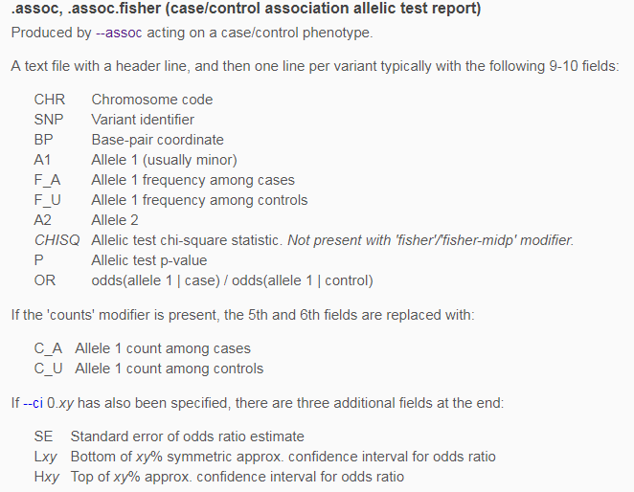
Always check which allele is the effect allele!
https://www.cog-genomics.org/plink/1.9/formats#assoc
Notes:
"Let’s break down the .assoc file format. It’s made by PLINK’s --assoc command and has columns like chromosome, SNP ID, position, the two alleles (A1 and A2), their frequencies in cases and controls, the chi-square statistic, the p-value, and the odds ratio. The p-value tells us if the SNP is significantly associated with the disease—a smaller p-value means a stronger association.
If we add extra options, like --ci, PLINK can also give us a confidence interval for the odds ratio, which tells us how precise our estimate is. Always check which allele is the effect allele—the one associated with the disease."

Slide 39
Logistic and linear regression
Allowing the inclusion of covariates
Notes:
"Sometimes we need to adjust our analysis for other factors, like ancestry or age. Logistic regression is used for case-control studies and lets us include these extra factors, called covariates, to make our results more accurate. For continuous traits, like height, we use linear regression instead. These methods help us control for things that might affect the results but aren’t related to the SNPs we’re studying."

Slide 40
How many covariates does the file adpc.txt have? What are they?
FID IID PC1 PC2 PC3 PC4
WGAAD 10 0.0550949 0.0507711 0.00845787 -0.00116914
WGAAD 15 0.0470604 0.0474843 0.00315769 0.00810905
WGAAD 18 0.0564277 0.0471303 0.00803162 -0.00242266
WGAAD 20 0.0564051 0.0436962 0.00419304 -0.007482
WGAAD 24 0.0540288 0.0477145 0.00711973 -0.00223988
WGAAD 25 0.0475798 0.0504094 0.00207224 0.00637812
WGAAD 28 0.0570727 0.0493075 0.00609508 -0.00164
WGAAD 29 0.054579 0.0496459 0.00995307 -0.00327564
WGAAD 31 0.0552207 0.0516809 0.00705046 -0.00485599
They are principal components of genetic ancestry
Notes:
"Here’s an example of a file with covariates, called adpc.txt. It has columns for family ID, individual ID, and four principal components—PC1, PC2, PC3, and PC4. Principal components come from the PCA we talked about earlier, and they represent differences in ancestry. We have four covariates here, and we can use them in our analysis to adjust for ancestry, making sure it doesn’t mess up our results."

Slide 41
2. Logistic regression with PC1-PC4 as covariates
plink
--bfile adclean.cc
--logistic
--covar adpc.txt
--out 2.1_adclean.cc
--freq can be added to create a separate file with the MAF (only founders) and this can be merged with the results
--beta can be added to obtain regression coefficients instead of odds ratios

Slide 42
Exercise 2.1. Logistic regression with PC1-PC4 as covariates
2.1_adclean.cc.log
Options in effect:
--bfile adclean.cc
--covar adpc.txt
--logistic
--out 2.1_adclean.cc
Random number seed: 1551416198
64148 MB RAM detected; reserving 32074 MB for main workspace.
297237 variants loaded from .bim file.
352 people (188 males, 164 females) loaded from .fam.
352 phenotype values loaded from .fam.
Using 1 thread (no multithreaded calculations invoked.
--covar: 4 covariates loaded.
Before main variant filters, 352 founders and 0 nonfounders present.
Calculating allele frequencies... done.
Total genotyping rate is 0.985941.
297237 variants and 352 people pass filters and QC.
Among remaining phenotypes, 170 are cases and 182 are controls.
Writing logistic model association results to 2.1_adclean.cc.assoc.logistic ..

Slide 43
Logistic regression with PC1-PC4 as covariates
2.1_adclean.cc.assoc.logistic
CHR SNP BP A1 TEST NMISS OR STAT P
1 rs3094315 752566 C ADD 349 1.352 1.437 0.1508
1 rs3094315 752566 C PC1 349 4.426e-50 -1.866 0.06207
1 rs3094315 752566 C PC2 349 8.759e+17 0.7017 0.4828
1 rs3094315 752566 C PC3 349 2.97e+21 0.8452 0.398
1 rs3094315 752566 C PC4 349 9.61e-25 -1.017 0.3094
1 rs4040617 779322 G ADD 351 1.276 1.047 0.2953
1 rs4040617 779322 G PC1 351 8.682e-51 -1.892 0.05843
1 rs4040617 779322 G PC2 351 2.841e+21 0.8415 0.4001
1 rs4040617 779322 G PC3 351 2.764e+17 0.687 0.4921
Notes:
When you run logistic regression in PLINK with covariates, the output file (e.g., .assoc.logistic) includes a column called "TEST," which describes the type of statistical test done for each SNP. "ADD": This stands for an additive model. It means PLINK is testing how the number of copies of a specific SNP version (allele) affects the disease risk. For example, if a SNP has alleles ‘A’ and ‘G,’ the additive model checks if having 0, 1, or 2 ‘A’ alleles increases the risk step by step. It’s the most common way to test SNPs in GWAS because it assumes the effect adds up with each copy. "PC1-4": This indicates that the test also includes the four principal components (PC1, PC2, PC3, PC4) as covariates. These PCs adjust for ancestry differences, so the "ADD" test is corrected for population structure. In the output, you might see a p-value for the SNP’s effect and separate p-values or coefficients for PC1–PC4, showing how much they influence the result. What it means: If the TEST column says "ADD PC1-4," it’s telling you the SNP’s association with the disease is tested using the additive model, while accounting for ancestry differences captured by the four PCs. A small p-value (e.g., less than 5 × 10⁻⁸) for the SNP suggests a real association, not just a result of ancestry.

Slide 44
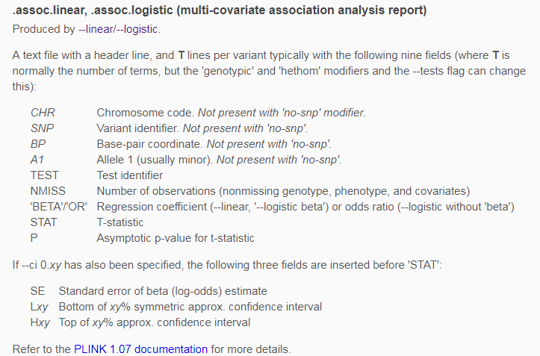
Logistic regression with PC1-PC4 as covariates
https://www.cog-genomics.org/plink/1.9/formats#assoc_linear

Slide 45
Exercise 2.2. Logistic regression with PC1-PC4 as covariates hiding the covariates)
plink
--bfile adclean.cc
--logistic hide-covar
--covar adpc.txt
--out 2.2_adclean.cc

Slide 46
Exercise 2.2. Logistic regression with PC1-PC4 as covariates hiding the covariates)
2.2_adclean.cc.log
Options in effect:
--bfile adclean.cc
--covar adpc.txt
--logistic hide-covar
--out 2.2_adclean.cc
Random number seed: 1551713462
64148 MB RAM detected; reserving 32074 MB for main workspace.
297237 variants loaded from .bim file.
352 people (188 males, 164 females) loaded from .fam.
352 phenotype values loaded from .fam.
Using 1 thread (no multithreaded calculations invoked.
--covar: 4 covariates loaded.
Before main variant filters, 352 founders and 0 nonfounders present.
Calculating allele frequencies... done.
Total genotyping rate is 0.985941.
297237 variants and 352 people pass filters and QC.
Among remaining phenotypes, 170 are cases and 182 are controls.
Writing logistic model association results to 2.2_adclean.cc.assoc.logistic ...

Slide 47
Logistic regression with PC1-PC4 as covariates hiding the covariates)
2.2_adclean.cc.assoc.logistic
CHR SNP BP A1 TEST NMISS OR STAT P
1 rs3094315 752566 C ADD 349 1.352 1.437 0.1508
1 rs4040617 779322 G ADD 351 1.276 1.047 0.2953
1 rs4075116 1003629 G ADD 351 1.013 0.08192 0.9347
1 rs9442385 1097335 T ADD 350 0.6388 -1.587 0.1125
1 rs10907175 1130727 C ADD 343 1.353 1.063 0.2879
1 rs6603781 1158631 T ADD 344 1.496 1.817 0.06918
1 rs11260562 1165310 T ADD 352 0.8613 -0.4002 0.689
1 rs6685064 1211292 T ADD 348 0.8395 -0.529 0.5968
1 rs307378 1268847 T ADD 349 1.212 0.4058 0.6849

Slide 48
Let’s plot the results
QQ plots, Manhattan plots, and regional plots

Slide 49
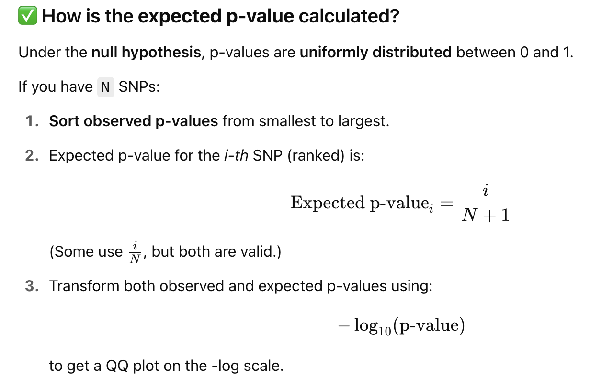
Notes:
1. At the tail (far left) — Above the diagonal
🔹 These are SNPs with much smaller p-values than expected under the null. ➡️ Interpretation:
Likely true associations with the phenotype.
This is where you expect to find your top hits.
📌 This is the good kind of deviation.
2. All across the curve — Systematic inflation
🔹 When many points are consistently above the diagonal (not just the tail): ➡️ Interpretation:
Could indicate inflation of test statistics.
Common causes:
Population stratification
Cryptic relatedness
Batch effects
Poor phenotype definitions
📌 You’ll often measure this with the λ (lambda) inflation factor — a λ > 1.1 is considered suspect.
3. Below the diagonal
🔹 This is rare, but would mean observed p-values are less significant than expected. ➡️ Often suggests:
Over-correction (e.g., too strict covariate control)
Random chance with small sample size
🧠 Summary Table:
Location of PointsMeaningInterpretationTail only (leftmost)Likely true positivesStrong SNP associationsThroughout curveTest statistic inflationQC or population issuesBelow lineDeflation or conservative correctionPossibly too strict correction

Slide 50
QQ plot
Checks the overall distribution of test statistics or –log10 p-values with the expectation under the null hypothesis of no association (the diagonal line shows where the points should fall under the null).
Evaluates systematic bias and inflation (undetected sample duplications, unknown familial relationships, gross population stratification, problems in QC…).
Lambda
It is the ratio of the median of the empirically observed distribution of the test statistic to the expected median.
It quantifies the extent of the bulk inflation and the excess false positive rate.
The expected median of the chi-square distribution with one degree of freedom is 0.455.
lambda=median(chi^2)/0.455
It should be close to 1.
Notes:
1. At the tail (far left) — Above the diagonal
🔹 These are SNPs with much smaller p-values than expected under the null. ➡️ Interpretation:
Likely true associations with the phenotype.
This is where you expect to find your top hits.
📌 This is the good kind of deviation.
2. All across the curve — Systematic inflation
🔹 When many points are consistently above the diagonal (not just the tail): ➡️ Interpretation:
Could indicate inflation of test statistics.
Common causes:
Population stratification
Cryptic relatedness
Batch effects
Poor phenotype definitions
📌 You’ll often measure this with the λ (lambda) inflation factor — a λ > 1.1 is considered suspect.
3. Below the diagonal
🔹 This is rare, but would mean observed p-values are less significant than expected. ➡️ Often suggests:
Over-correction (e.g., too strict covariate control)
Random chance with small sample size
🧠 Summary Table:
Location of PointsMeaningInterpretationTail only (leftmost)Likely true positivesStrong SNP associationsThroughout curveTest statistic inflationQC or population issuesBelow lineDeflation or conservative correctionPossibly too strict correction

Slide 51
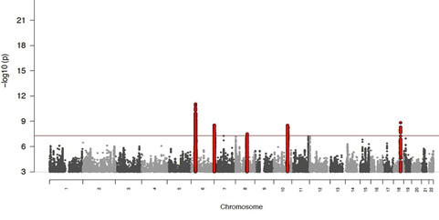
Manhattan plot
Plots the -log10 of the association p-value for each SNP against the genomic coordinates.
The strongest associations will have the smallest p-values and the –log10 of these p-values will have the highest height in the plot.
Notes:
A Manhattan plot is a graph that shows all the p-values from a GWAS across the entire genome, making it easy to spot significant associations. It’s called a "Manhattan" plot because the points look like a city skyline with tall "buildings."
The x-axis lists the chromosomes (1 through 22, plus X and Y) in order, with their positions along the DNA.
The y-axis shows the negative log10 of the p-values (e.g., a p-value of 0.00001 becomes about 5), so smaller p-values appear as taller bars.
Each dot represents a SNP. If a dot crosses a threshold line (usually around 7.3, which is -log10 of 5 × 10⁻⁸), it’s considered a strong candidate for being linked to the disease.
Different colors (e.g., blue, green, red) are often used to distinguish chromosomes, making it easier to see patterns.
Why it matters: It gives a big-picture view of the genome, helping us quickly identify regions where SNPs are significantly associated with the disease, which we can then study further.
Deviations from the identity line suggest either that the assumed distribution is incorrect or that the sample contains values arising in some other manner, as by a true association.
Since the underlying assumption in GWA studies is that the vast majority of assayed SNPs are not associated with the trait, strong deviations from the null suggest either a very highly associated and heavily genotyped locus or significant differences in population structure

Slide 52
qqman package in R to build Manhattan and QQ plots

Slide 53
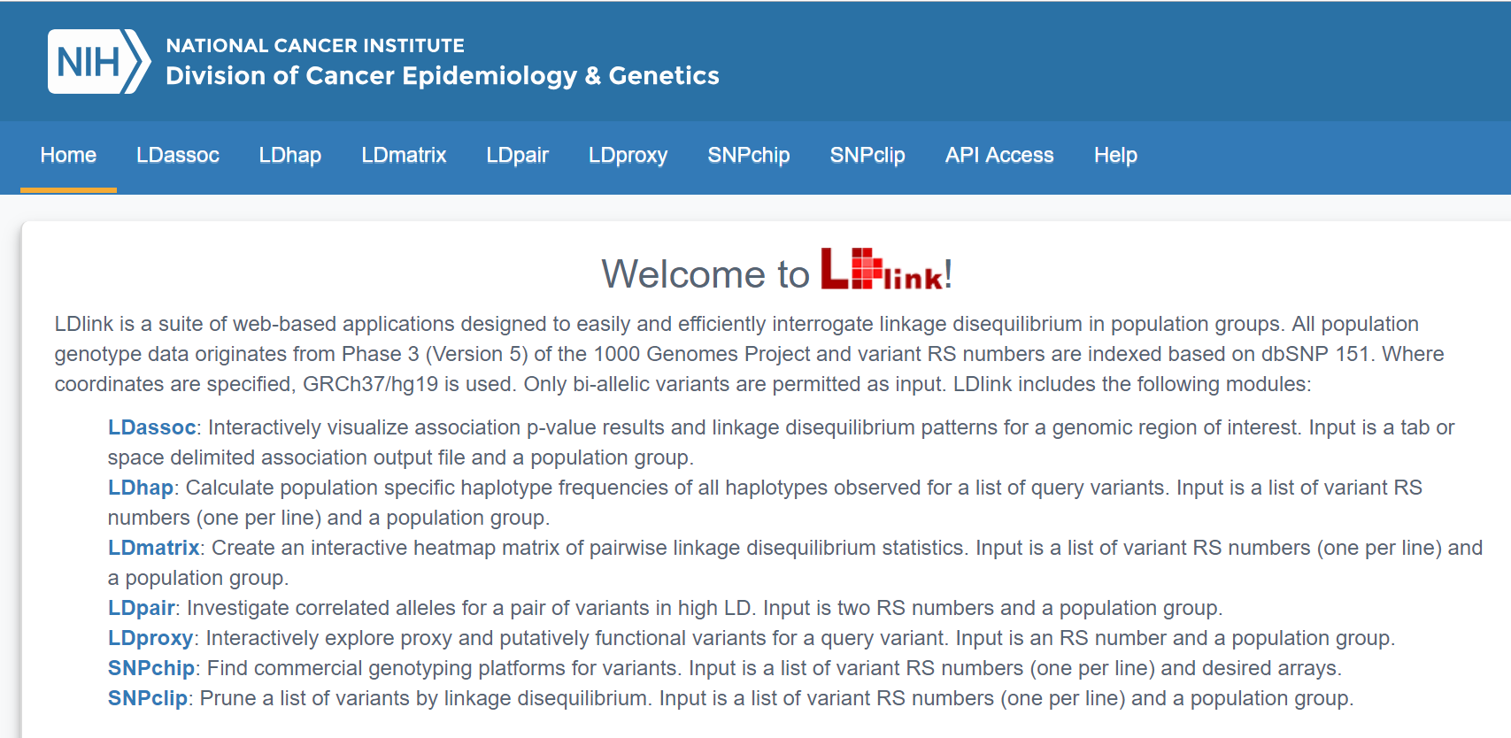
Regional plot
https://ldlink.nci.nih.gov/
Notes:
"After we find significant SNPs, we can make a regional plot to visualize the results. This slide shows a tool from the National Cancer Institute called LDassoc, which helps us make these plots. A regional plot shows all the SNPs in a specific area of the chromosome, with their p-values, so we can see which ones are most strongly associated with the disease and how they’re linked to each other through LD. It’s a great way to zoom in on a region of interest."

Slide 54
Exercise 2.3. Logistic regression with PC1-PC4 as covariates – plot the results
To prepare the file, do:
awk '{if (NR==1 || $1==19) print $1,$3,$2,$9}' 2.2_adclean.cc.assoc.logistic | grep -v NA > ld19.adclean.cc.logistic.txt
To find the name of the SNP, do:
sort -k4 -r ld19.adclean.cc.logistic.txt | head
CHR BP SNP P
19 261033 rs8105536 0.6398
19 277776 rs11084928 0.1609
19 293934 rs1106581 0.8085
19 301639 rs4897940 0.7669
rs4420638
Notes:
"Here’s an exercise to plot results for chromosome 19. First, we use a command to pull out data for chromosome 19 from our logistic regression results, focusing on the chromosome, position, SNP ID, and p-value. Then, we sort the data by p-value to find the most significant SNP. The output shows that rs8105536 on chromosome 19 has the smallest p-value, 0.6398, but that’s still not very significant—it’s much bigger than the 5 × 10⁻⁸ threshold we usually use in GWAS. We’d use this data to make a plot, like a regional plot, to see the associations in this area."

Slide 55
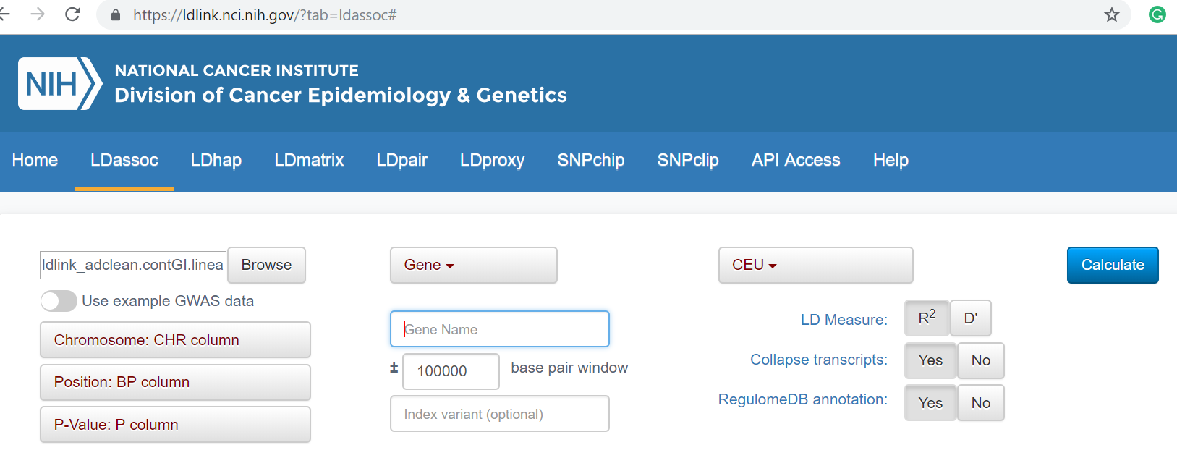

Slide 57
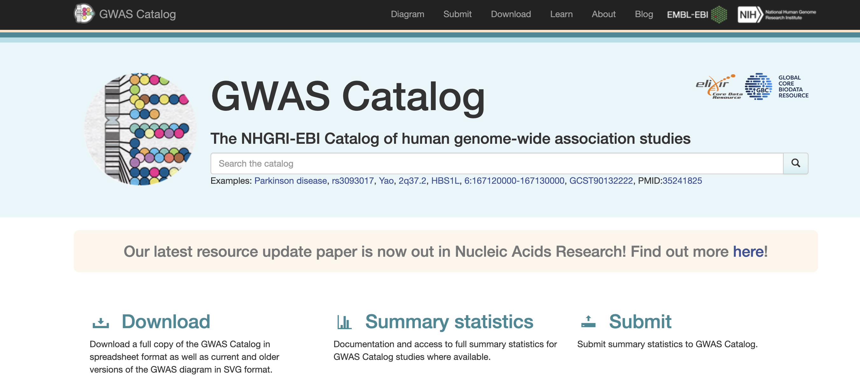
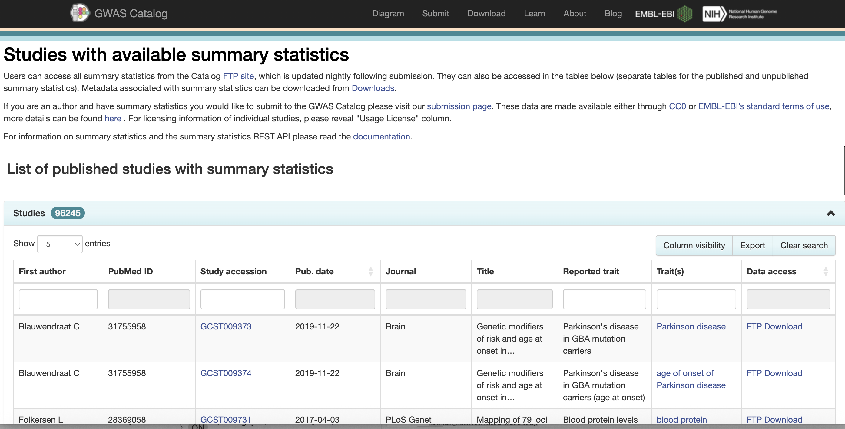
Public GWAS data
https://www.ebi.ac.uk/gwas/
Notes:
"GWAS data is often shared publicly so other researchers can use it. This slide shows a list of studies with available summary statistics, which include the p-values and odds ratios for each SNP. You can find these on websites like the GWAS Catalog. Each study lists things like the publication date, journal, title, and the trait they studied, like heart disease or height. This data is great for combining with other studies or doing follow-up analyses."

Slide 58
Post GWAS
PRS : Polygenic risk score to identify populations at risk for a trait/disease
Integration with transcriptomics to identify disease associated genes/cell types/tissue regions
Notes:
"After a GWAS, there’s more we can do with the results. One thing is calculating a Polygenic Risk Score, or PRS, which combines the effects of many SNPs to predict someone’s risk for a disease—like figuring out if they’re more likely to get diabetes. Another thing is combining GWAS data with transcriptomics, which looks at gene activity, to find out which genes, cell types, or tissues are involved in the disease. This helps us understand the biology behind the associations we found."
1. Fine-Mapping to Pinpoint Causal Variants
Goal: Narrow down GWAS loci to credible sets of causal SNPs.
Methods: Bayesian fine-mapping (e.g., SuSiE, FINEMAP), conditioning, credible intervals.
Benefit: Distinguish causal variants from those in LD.
🧬 2. Colocalization with eQTLs / sQTLs
Goal: Identify whether the same variant is responsible for both GWAS signal and gene regulation (eQTL).
Tools: COLOC, eCAVIAR, SMR/HEIDI.
Data: GTEx, single-cell eQTLs, spatial transcriptomics.
Output: Gene-tissue-trait triads (e.g., “this variant affects this gene in this cell type”).
🧠 3. Gene and Pathway Prioritization
Goal: Link SNPs to target genes and biological pathways.
Methods:
MAGMA, DEPICT, GSEA — for gene-set enrichment
PoPS, OpenTargets Genetics, GenePrioritization tools
Use: Focus functional studies on top pathways and gene candidates.
🧭 4. Cell Type / Tissue Resolution
Goal: Map genetic risk to specific cell types using single-cell RNA-seq / spatial transcriptomics.
Tools:
LDSC-SEG, S-LDSC, Celldex, MuSiC, sc-linker
SPOTlight, Tangram, Cell2location (for spatial)
Example: Link schizophrenia risk loci to inhibitory neurons in prefrontal cortex.
🔄 5. Mendelian Randomization (MR)
Goal: Test whether a biomarker (gene, protein, lipid) causally influences the disease.
Data: Summary-level GWAS + exposure QTL data
Tools: TwoSampleMR, MR-Egger, CAUSE
Use: Prioritize drug targets, understand mechanisms.
🧪 6. Drug Target Discovery
Goal: Identify druggable genes supported by human genetics.
Tools: OpenTargets, LINSIGHT, DGIdb
Example: PCSK9 inhibitors developed after strong LDL GWAS hits.
🧬 7. PheWAS & Cross-Trait Analysis
PheWAS: Test top SNPs across hundreds of traits to detect pleiotropy.
Genetic correlation: LDSC, Popcorn to quantify shared heritability.
Applications: Understand comorbidities and shared biology.
🧑‍🤝‍🧑 8. Population Genetics & Evolution
Goal: Study selective pressures, allele frequency divergence.
Tools: iHS, FST, SDS, ALDER
Use: E.g., detect positive selection at immune loci.
🧭 9. Functional Validation
Goal: Experimentally test causal SNPs/genes using:
CRISPR/Cas9 editing
Reporter assays
Perturb-seq
Organoids or iPSC-derived models
🌐 10. Integrative Risk Models
Combine PRS with:
Lifestyle factors
Imaging biomarkers (e.g., MRI)
Clinical lab data
Use: Precision medicine, disease subtyping, early screening.

